Slide 1
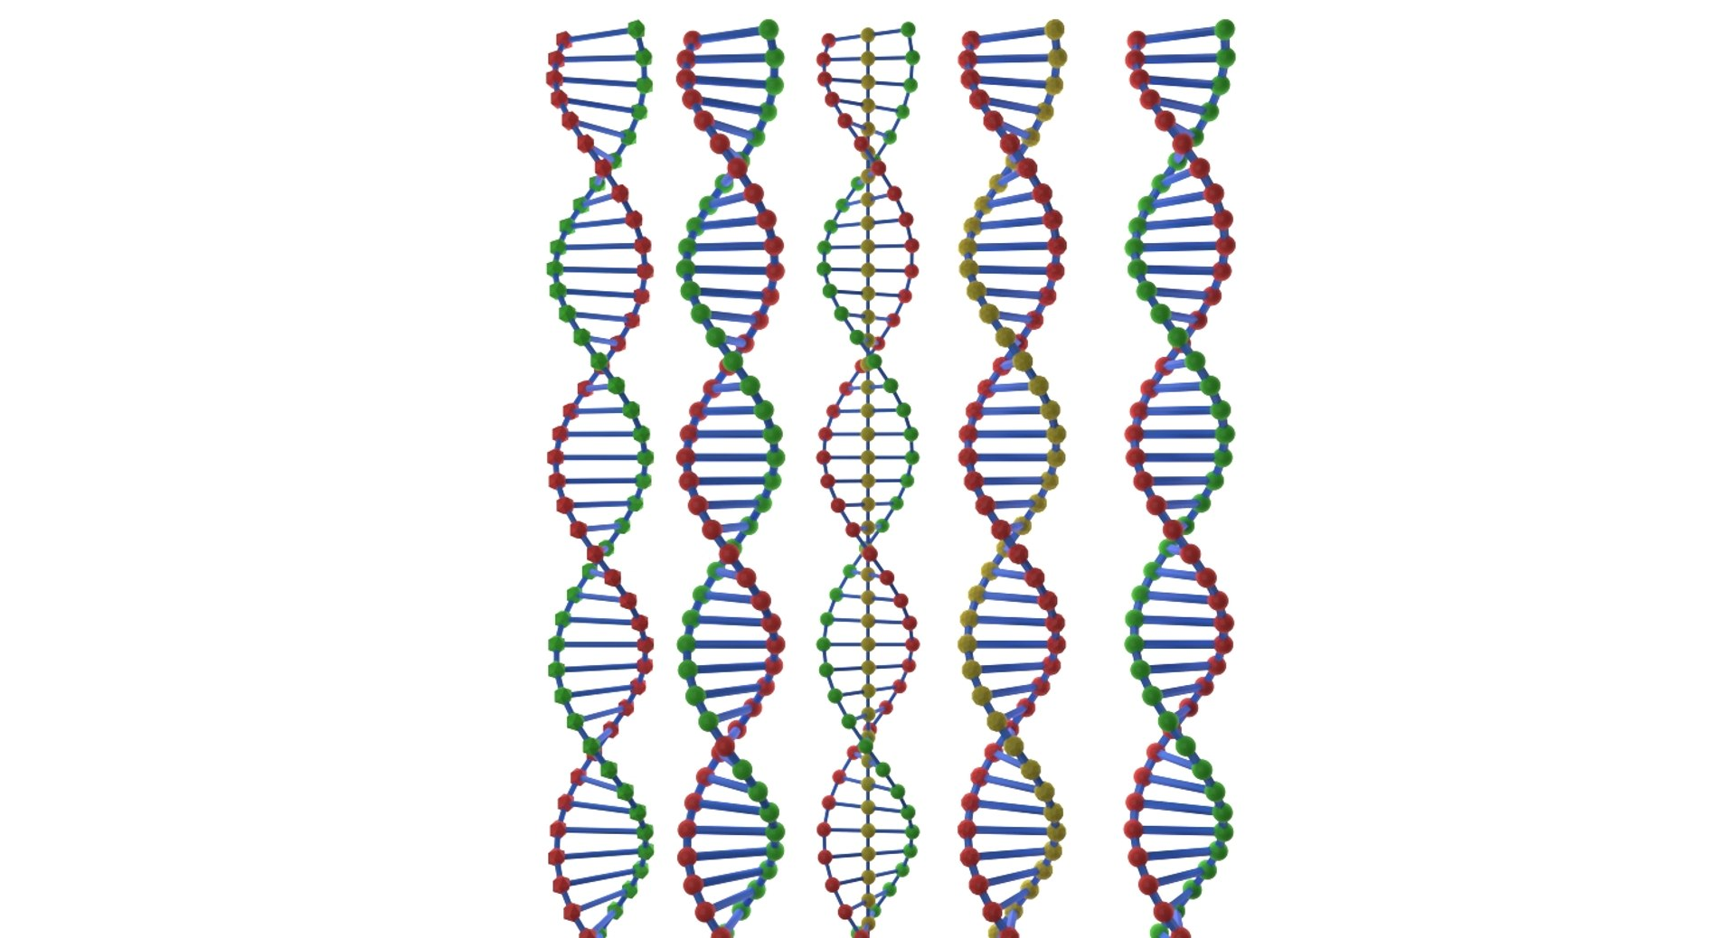
THE WORLD
June 2026
ГГУ им. Ф.Скорины
Mathematics in Medicine: VI All‑Russian Conference
On June 25–26, 2026, Yekaterinburg will host the VI All‑Russian Conference with international participation, “Mathematics in Medicine”. The event is dedicated to current interdisciplinary problems related to possible and used applications of mathematical methods, models and information technologies in medicine.

Slide 2

THE WORLD
June 2026
ГГУ им. Ф.Скорины
XV International Seminar “Discrete Mathematics and Its Applications”
From June 22 to 26, 2026, Lomonosov Moscow State University will hold the XV International Scientific Seminar “Discrete Mathematics and Its Applications” named after Academician O.B. Lupanov. The programme includes: theory of functional systems, synthesis, complexity and reliability of control systems, combinatorial analysis, mathematical theory of intelligent systems, discrete geometry, graph theory, coding theory and mathematical issues of information security.

Slide 3
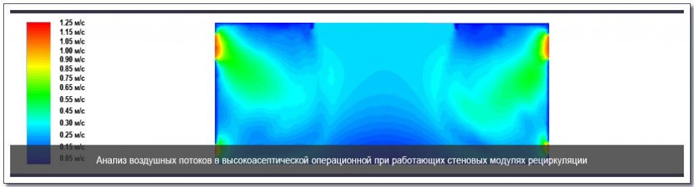
THE WORLD
June 2026
ГГУ им. Ф.Скорины
XV International Seminar “Discrete Mathematics and Its Applications” Numerical Methods and Continuum Mechanics
On June 15–16, 2026, Moscow will host the scientific conference “Numerical Methods, Continuum Mechanics and Programming”, dedicated to the centenary of the birth of three outstanding scientists – staff members of the Computing Centre of the Russian Academy of Sciences: A.A. Abramov, V.M. Kurochkin and Yu.D. Shmyglevsky.

Slide 4
THE WORLD
June 2026
ГГУ им. Ф.Скорины
Prize for Young Mathematicians of Russia
The next award ceremony of the Prize for Young Mathematicians of Russia will take place in 2026. The prize is awarded to Russian citizens for significant achievements in scientific research in the mathematical sciences in three categories: for students, postgraduates and young scientists under 35. The coordination of the Jury is carried out by the Sirius International Mathematical Centre. Nominations for the prize are accepted until July 12, 2026.

