Slide 1
Events in september 2025

Slide 2
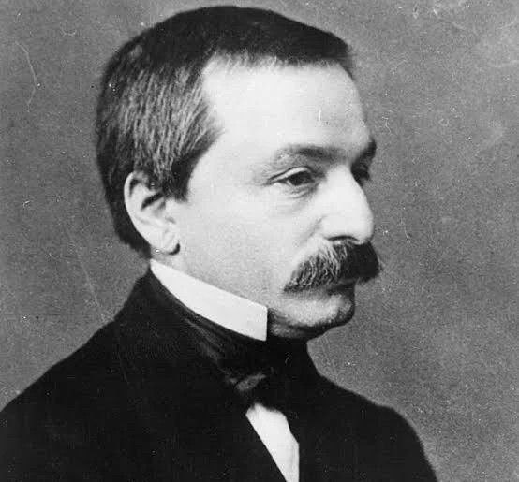
September 8 — 120 years since his death (1905)
Leopold Kronecker
Contribution: Germany mathematician, known for his famous phrase "God created integers, everything else is the work of man." He made significant contributions to number theory and algebra. The Kronecker-Weberer theorem is a key result in the theory of class fields.
September 8

Slide 3
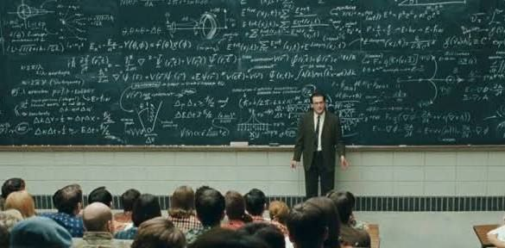
September 8-9
Annual Symposium of the European Mathematical Society "Differential Equations in Mathematical Physics".
Location: Warsaw
Program: More than 100 reports

Slide 4

September 20 (Saturday)
Workshop "Mathematics and Artificial Intelligence: Basic Algorithms" for teachers and students.
Location: Online, MIT OpenCourseWare platform.
Link for participation: will be published on September 10 on the course website.
September 20

Slide 5
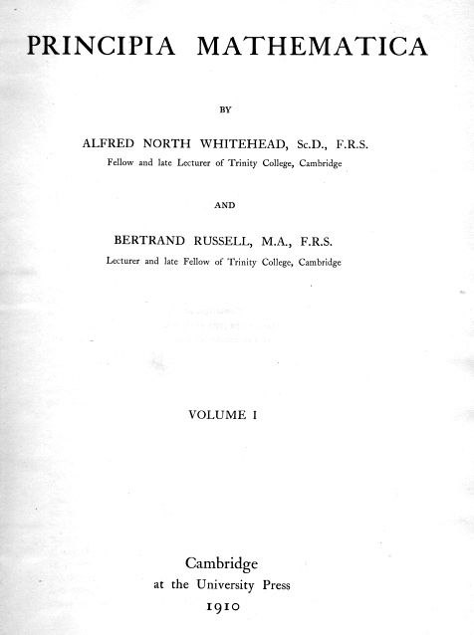
September 28
September 28 — 115 years old (1910)
Publication of the first volume of "Principia Mathematica".
Event: Alfred North Whitehead and Bertrand Russell began publishing their monumental three-volume work, in which they attempted to deduce all mathematics from the foundations of logic. This work became the cornerstone of mathematical logic and the foundations of mathematics in the 20th century.

