Slide 1
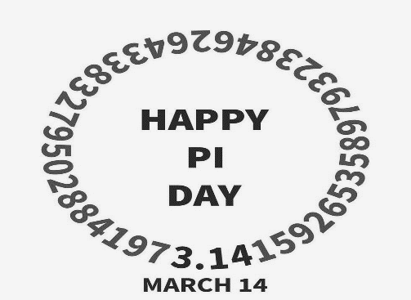
THE WORLD
Important events of March
March 14 - Pi Day
Pi Day is an unofficial mathematical holiday dedicated to one of the most famous constants in mathematics, the number π (pi), which is approximately equal to 3.1415926535. The holiday is celebrated annually on March 14, which in the American date format is 3/14, which resembles the first digits of pi. In addition to celebrating Pi Day, March 14 is also celebrated as International Mathematics Day.
Who invented this holiday and when?
The idea of celebrating Pi Day belongs to the American physicist Larry
Shaw, who worked at the Exploratorium Science Museum in San
Francisco. In 1987, a physicist noticed that in the American date recording
system (month / day), the date March 14 is 3/14 and the time 1:59:26
coincides with the first digits of the number π = 3.1415926

Slide 2
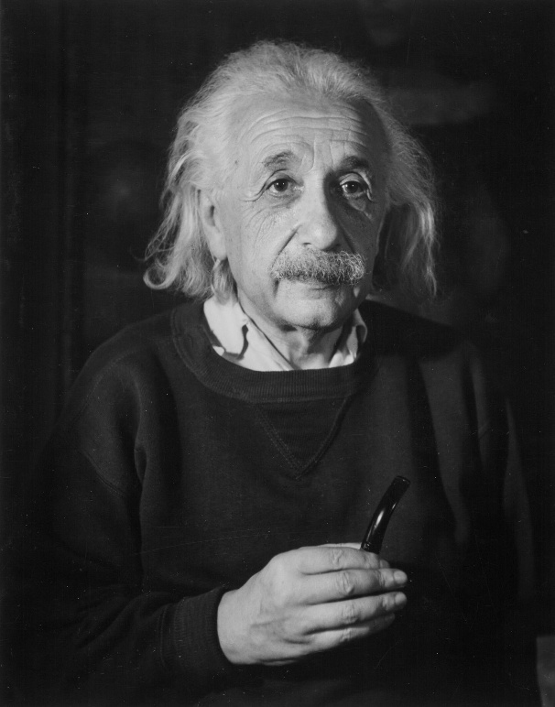
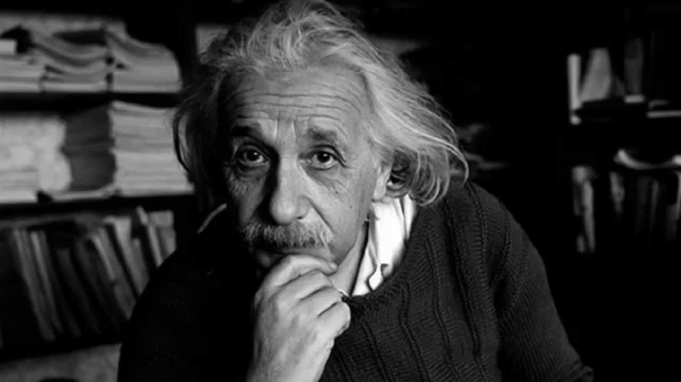
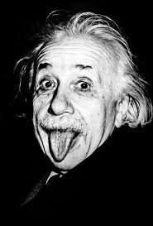
March 14, 1879 — birth of Albert Einstein
Albert Einstein, a brilliant scientist and Nobel Prize winner, was born into a poor Jewish family on March 14, 1879, in the German city of Ulm. His theory of relativity became a discovery that revolutionized world science, and led humanity on a completely new path. Einstein had a lot in common with our country. As you know, he was even offered to become the second president of Israel. This happened in 1952 after the death of the first president Chaim Weizmann. The scientist rejected the proposal of Prime Minister David Ben-Gurion, citing a lack of experience in government activities. "I am deeply touched by the proposal of the State of Israel, but with regret and regret I have to reject it," he wrote in response.

Slide 3
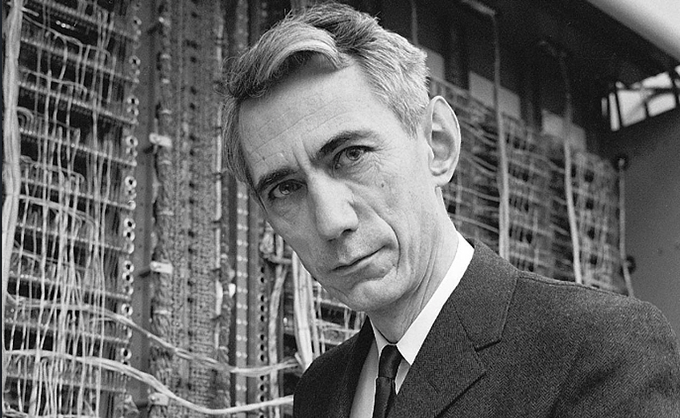
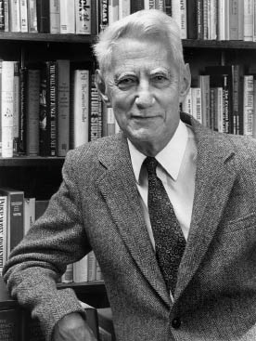
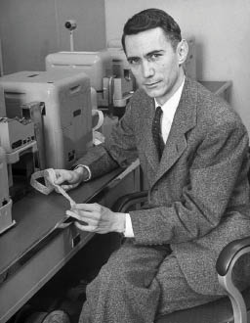
March 12, 1903 - Claude Shannon was born
Claude Elwood Shannon was born on March 12, 1903 in Petocki, the son of a lawyer and a foreign language teacher. His older sister, Catherine, was interested in mathematics and eventually became a professor, while Shannon's father combined his work as a lawyer with amateur radio. A distant relative of the future engineer was the world-famous inventor Thomas Edison, who had 1,093 patents. Shannon graduated from comprehensive secondary school in 1921 at the age of sixteen, while receiving additional education at home. His father bought him construction kits and amateur radio sets and promoted his son's technical creativity in every possible way, while his sister attracted him to in-depth mathematics studies. Shannon fell in love with both of these worlds—engineering and mathematics.

Slide 4
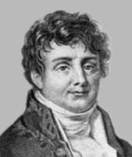
Jean-Baptiste Joseph Fourier
Jean-Baptiste Joseph Fourier (fr. Jean-Baptiste Joseph Fourier) was born on March 21, 1768 in Auxerre (France). He was educated at a military school in his hometown Auxerre, after graduation he remained there as a teacher, later, in 1796-1798, he taught at the Polytechnic School.
His first works relate to algebra. The theorem on the number of real roots of an algebraic equation lying between these boundaries, named after Fourier, was already stated by him in lectures in 1796. Its full solution was obtained by Storm only in 1829.
The main topic of Fourier's research was mathematical physics. In 1807 and 1811, he presented to the Paris Academy of Sciences his first discoveries on the theory of heat propagation in a solid, and in 1822 published the Analytical Theory of Heat, which played a major role in the subsequent history of mathematics.

