Slide 1
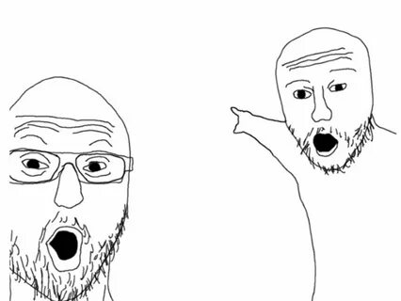
THE WORLD
Unexpectedly important news!!!
Stay tuned and you will learn about the events that took place during the period April - May 2025.

Slide 2
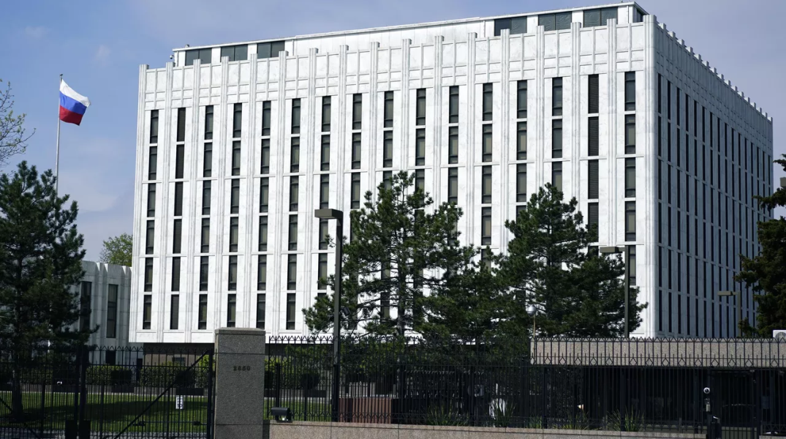
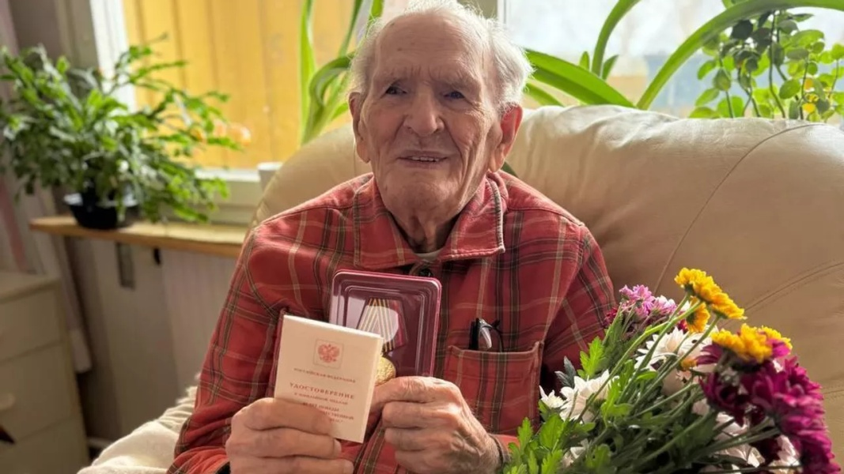
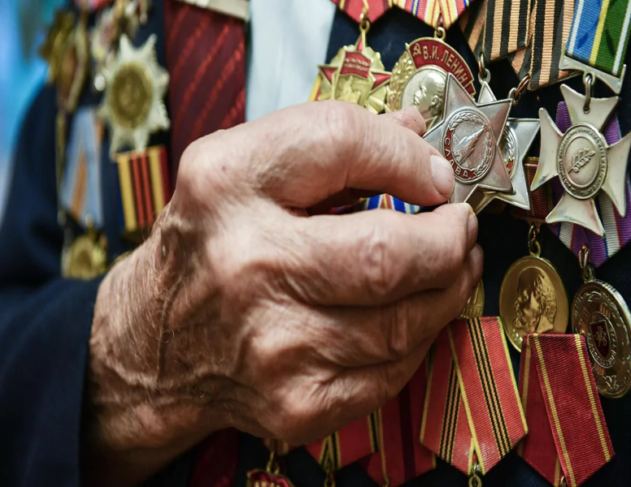
April 30th
Russian volunteers from Florida presented jubilee medals "80 years of Victory in the Great Patriotic War of 1941-1945" to 11 war veterans living in the state. The veterans were very pleased. Some of them didn't let our volunteers go for a long time, telling us about their lives and what they had to go through. And everyone thanked them for being remembered.

Slide 3
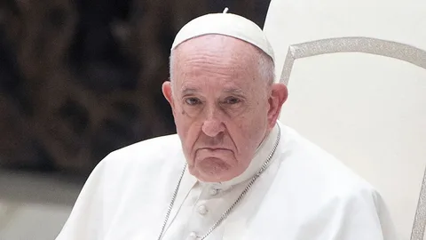
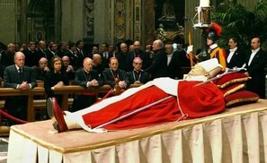
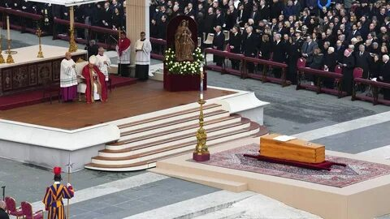
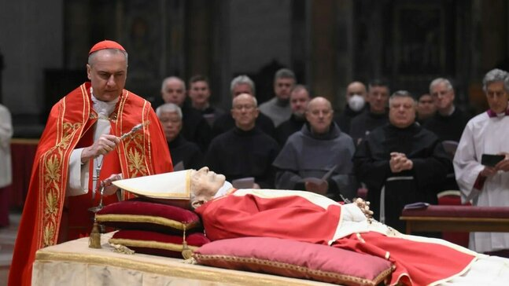
21 April
Pope Francis died at the age of 88 on Easter Monday, April 21, 2025 at 07:35 at his residence in the Vatican. The death was announced by Cardinal Kevin Farrell on the air of the Vatican TV channel Vatican Media and in a video message. The pontiff passed away after a long period of declining health.

Slide 4
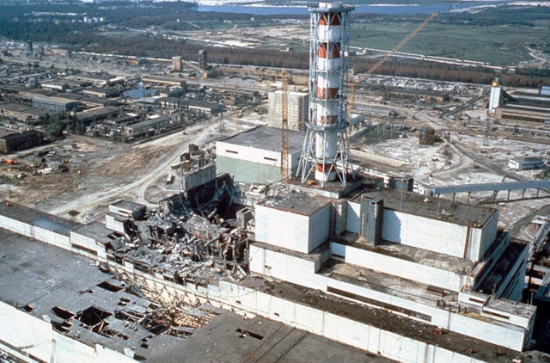
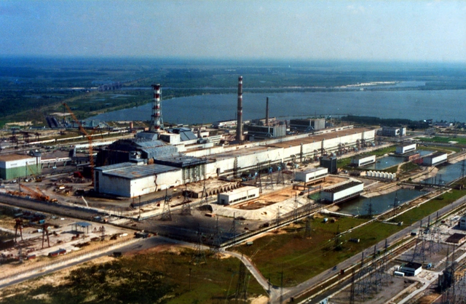
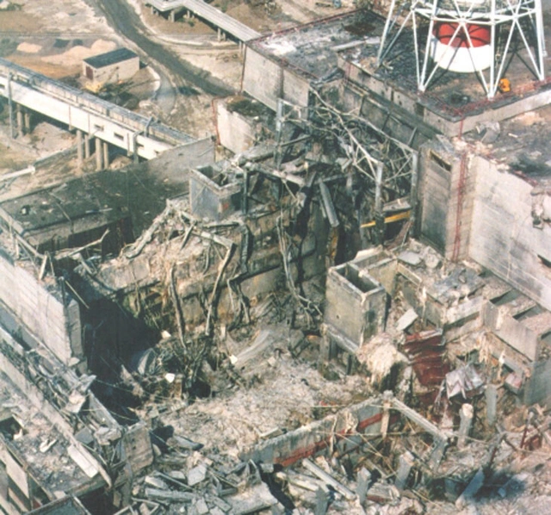
April 26th
39 years since the Chernobyl disaster.
The accident at the Chernobyl nuclear power plant, which occurred on the night of April 26, 1986, became the largest man-made disaster in the history of mankind. Every year on this day, the victims of this tragedy are remembered in Ukraine and around the world.
This year marks the 39th anniversary of the nuclear disaster at the Chernobyl nuclear power plant. On April 26, 1986, at 1:23 a.m., with an interval of several seconds, two powerful explosions occurred at the fourth power unit of the station.

Slide 5
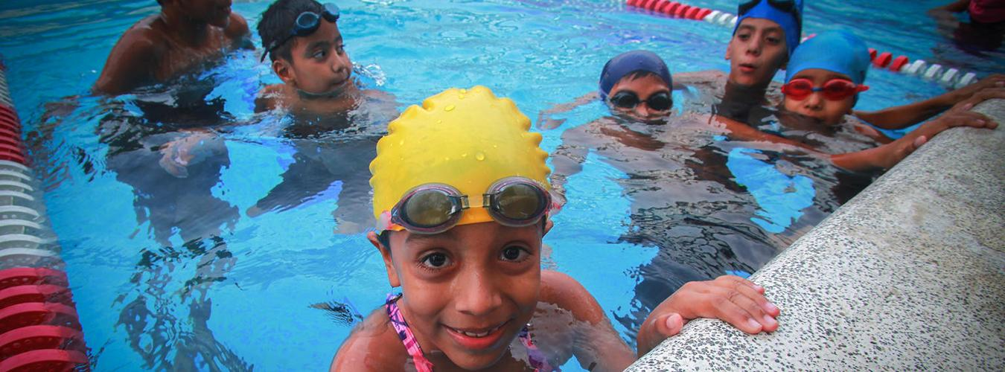
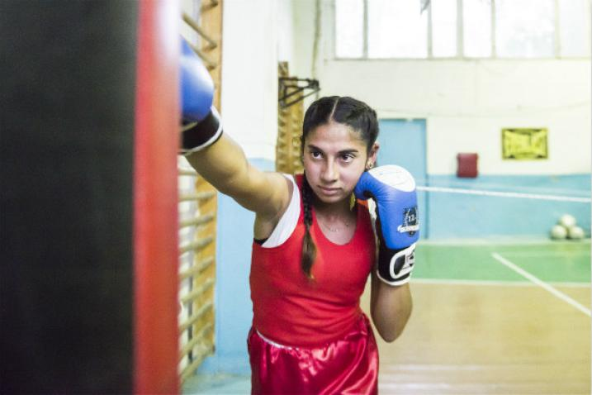
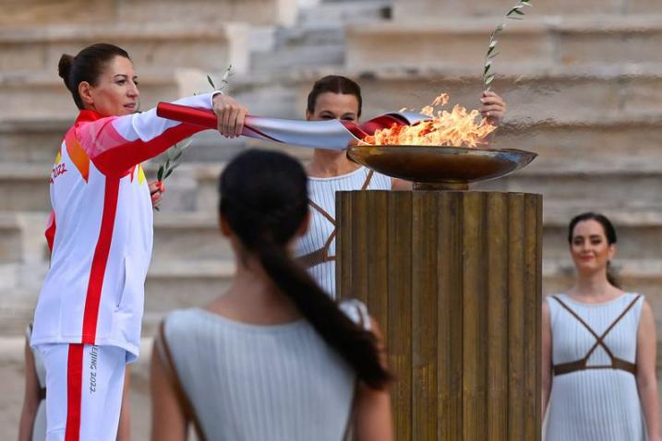
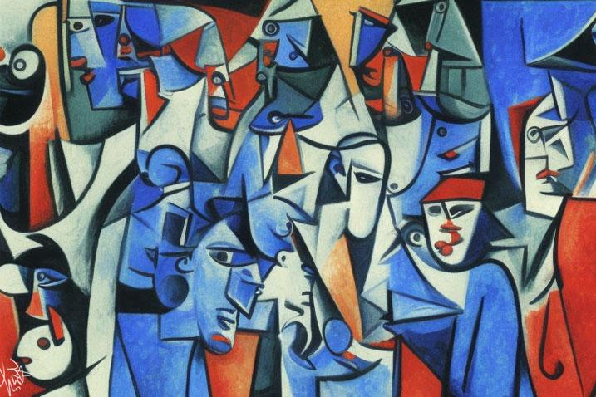
6 april
The International Day of Sport for Development and Peace, celebrated annually on April 6, provides an opportunity to demonstrate the important role of sport and physical activity in the lives of people around the world.
Sport is a powerful tool for strengthening social ties and promoting sustainable development and peace, as well as solidarity and respect for all.
On the eve of the Second World Summit on Social Development in 2025, International Sports Day will focus on the social integration of the most marginalized groups.

Slide 6
thanks for your attention!

