Slide 1
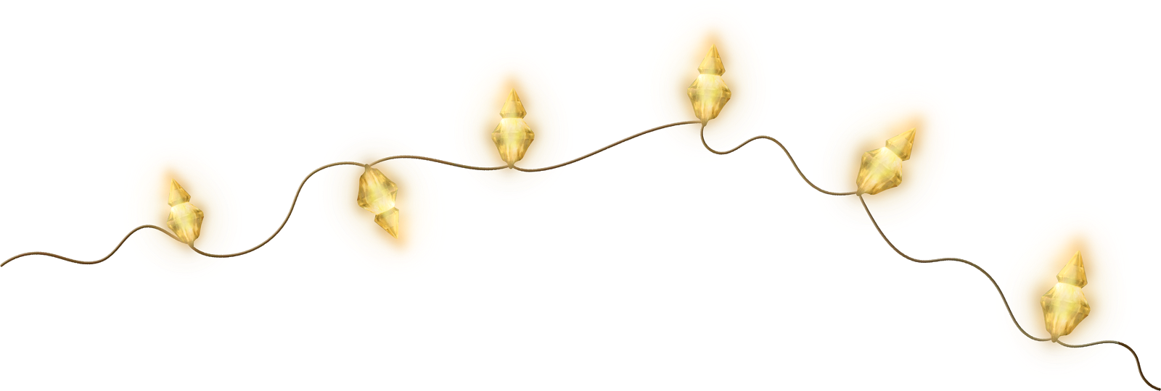
December

Slide 2
December

Slide 3
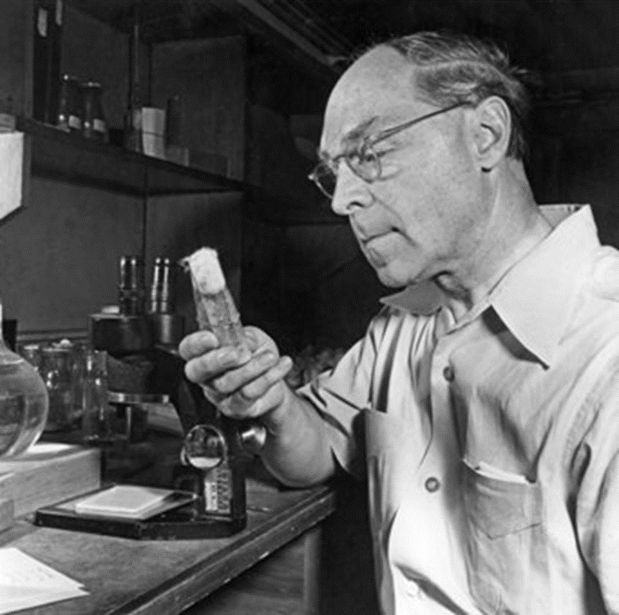
December 21, 1890
Herman Joseph Moeller (Muller)
December

Slide 4
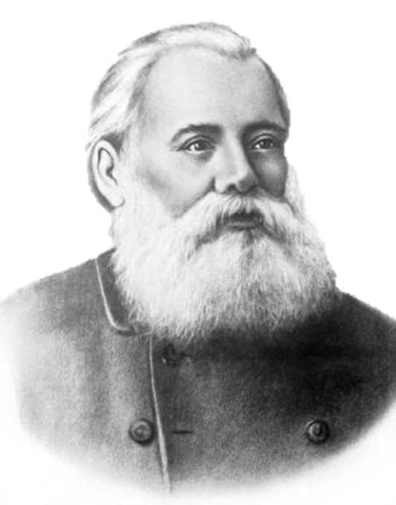
Vladimir Vasilyevich Markovnikov
December 22, 1838 - February 11, 1904
Herman Joseph Moeller (Muller)
December 21, 1890 - April 5, 1967
December
American geneticist. In 1912-1915, he participated in the development of the chromosomal theory of heredity, according to which chromosomes enclosed in the cell nucleus are carriers of genes and represent the material basis of heredity. He was awarded the Nobel Prize in Physiology or Medicine "for the discovery of the appearance of mutations under the influence of X-ray radiation" (1946).
Russian organic chemist. He discovered fatty acid isomerism in 1865. In his dissertation "Materials on the mutual influence of atoms in chemical compounds" in 1869, he established a number of patterns concerning substitution, addition, and cleavage reactions. Since the early 1880s, he has been exploring Caucasian oil. He discovered and studied a new class of hydrocarbons, which he named naphthenes.

Slide 5
Herman Joseph Moeller (Muller)
Vladimir Vasilyevich Markovnikov
December 21, 1890
December
December 22, 1838 - February 11, 1904
American geneticist. In 1912-1915, he participated in the development of the chromosomal theory of heredity, according to which chromosomes enclosed in the cell nucleus are carriers of genes and represent the material basis of heredity. He was awarded the Nobel Prize in Physiology or Medicine "for the discovery of the appearance of mutations under the influence of X-ray radiation" (1946).
Russian organic chemist. He discovered fatty acid isomerism in 1865. In his dissertation "Materials on the mutual influence of atoms in chemical compounds" in 1869, he established a number of patterns concerning substitution, addition, and cleavage reactions. Since the early 1880s, he has been exploring Caucasian oil. He discovered and studied a new class of hydrocarbons, which he named naphthenes.
December 27, 1822 — September 28, 1895
Louis Pasteur

Slide 6
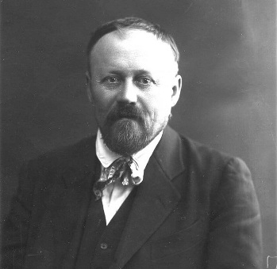
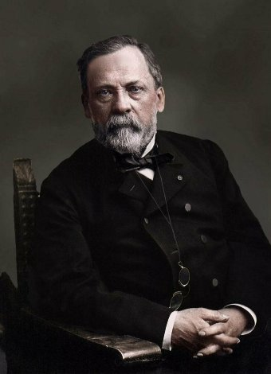
Daniil Kirillovich Zabolotny
December 28, 1866 — December 15, 1929
Vladimir Vasilyevich Markovnikov
December 22, 1838 - February 11, 1904
Russian microbiologist. One of the founders of Russian epidemiology. For many years, he also studied cholera epidemics and took an active part in expeditions to combat cholera, malaria and typhus. In 1898, he organized the first Russian Department of Bacteriology at St. Petersburg University. He also founded the first Department of Epidemiology in the USSR at the Odessa Medical Institute.
Herman Joseph Moeller (Muller)
Louis Pasteur
December 27, 1822 — September 28, 1895
December
French microbiologist, chemist. The founder of microbiology and immunology. He proved that fermentation is caused by the activity of various types of microorganisms. He discovered the phenomenon of anaerobiosis and the existence of strictly anaerobic bacteria. He has studied a number of infectious diseases of animals and humans, having established that they are caused by specific pathogens. Based on his developed understanding of artificial immunity, he proposed methods of preventive vaccinations.
December 21, 1890
American geneticist. In 1912-1915, he participated in the development of the chromosomal theory of heredity, according to which chromosomes enclosed in the cell nucleus are carriers of genes and represent the material basis of heredity. He was awarded the Nobel Prize in Physiology or Medicine "for the discovery of the appearance of mutations under the influence of X-ray radiation" (1946).
Russian organic chemist. He discovered fatty acid isomerism in 1865. In his dissertation "Materials on the mutual influence of atoms in chemical compounds" in 1869, he established a number of patterns concerning substitution, addition, and cleavage reactions. Since the early 1880s, he has been exploring Caucasian oil. He discovered and studied a new class of hydrocarbons, which he named naphthenes.

Slide 7
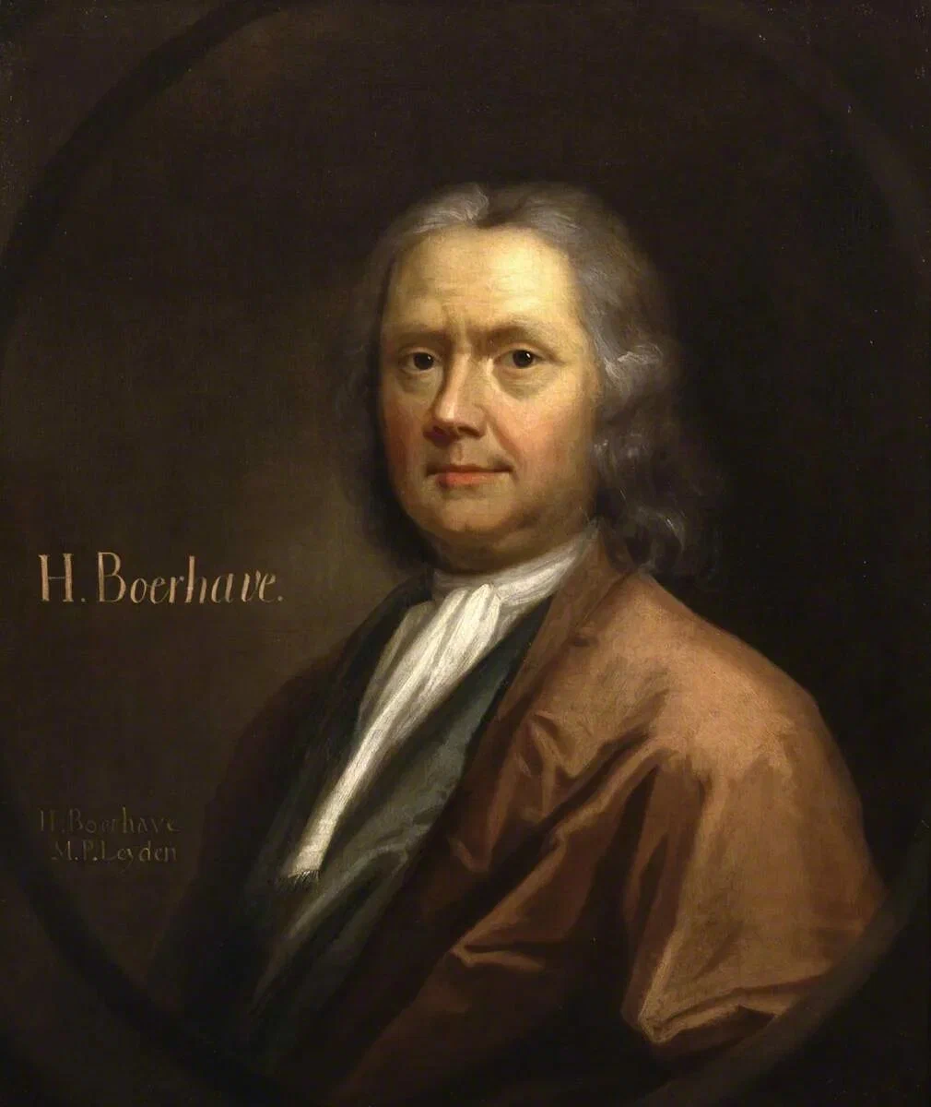
French microbiologist, chemist. The founder of microbiology and immunology. He proved that fermentation is caused by the activity of various types of microorganisms. He discovered the phenomenon of anaerobiosis and the existence of strictly anaerobic bacteria. He has studied a number of infectious diseases of animals and humans, having established that they are caused by specific pathogens. Based on his developed understanding of artificial immunity, he proposed methods of preventive vaccinations.
Louis Pasteur
Herman Burgave (Burhave)
Vladimir Vasilyevich Markovnikov
Dutch physician, botanist and chemist. He created the first scientific clinic. He was the first to use a thermometer and a magnifying glass in his research. In the published catalog of the Leiden Botanical Garden in 1709, he described and classified new plant species. He showed that mercury does not change during prolonged heating and repeated distillations.
December 22, 1838 - February 11, 1904
December 31, 1668 — September 23, 1738
December 27, 1822 — September 28, 1895
Herman Joseph Moeller (Muller)
Daniil Kirillovich Zabolotny
December
December 21, 1890
December 28, 1866 — December 15, 1929
Russian microbiologist. One of the founders of Russian epidemiology. For many years, he also studied cholera epidemics and took an active part in expeditions to combat cholera, malaria and typhus. In 1898, he organized the first Russian Department of Bacteriology at St. Petersburg University. He also founded the first Department of Epidemiology in the USSR at the Odessa Medical Institute.
American geneticist. In 1912-1915, he participated in the development of the chromosomal theory of heredity, according to which chromosomes enclosed in the cell nucleus are carriers of genes and represent the material basis of heredity. He was awarded the Nobel Prize in Physiology or Medicine "for the discovery of the appearance of mutations under the influence of X-ray radiation" (1946).
Russian organic chemist. He discovered fatty acid isomerism in 1865. In his dissertation "Materials on the mutual influence of atoms in chemical compounds" in 1869, he established a number of patterns concerning substitution, addition, and cleavage reactions. Since the early 1880s, he has been exploring Caucasian oil. He discovered and studied a new class of hydrocarbons, which he named naphthenes.

Slide 8
French microbiologist, chemist. The founder of microbiology and immunology. He proved that fermentation is caused by the activity of various types of microorganisms. He discovered the phenomenon of anaerobiosis and the existence of strictly anaerobic bacteria. He has studied a number of infectious diseases of animals and humans, having established that they are caused by specific pathogens. Based on his developed understanding of artificial immunity, he proposed methods of preventive vaccinations.
Louis Pasteur
Vladimir Vasilyevich Markovnikov
December 22, 1838 - February 11, 1904
Daniil Kirillovich Zabolotny
December 27, 1822 — September 28, 1895
December 28, 1866 — December 15, 1929
Herman Burgave (Burhave)
Herman Joseph Moeller (Muller)
December 31, 1668 — September 23, 1738
Dutch physician, botanist and chemist. He created the first scientific clinic. He was the first to use a thermometer and a magnifying glass in his research. In the published catalog of the Leiden Botanical Garden in 1709, he described and classified new plant species. He showed that mercury does not change during prolonged heating and repeated distillations.
December
December 21, 1890
American geneticist. In 1912-1915, he participated in the development of the chromosomal theory of heredity, according to which chromosomes enclosed in the cell nucleus are carriers of genes and represent the material basis of heredity. He was awarded the Nobel Prize in Physiology or Medicine "for the discovery of the appearance of mutations under the influence of X-ray radiation" (1946).
Russian microbiologist. One of the founders of Russian epidemiology. For many years, he also studied cholera epidemics and took an active part in expeditions to combat cholera, malaria and typhus. In 1898, he organized the first Russian Department of Bacteriology at St. Petersburg University. He also founded the first Department of Epidemiology in the USSR at the Odessa Medical Institute.
Russian organic chemist. He discovered fatty acid isomerism in 1865. In his dissertation "Materials on the mutual influence of atoms in chemical compounds" in 1869, he established a number of patterns concerning substitution, addition, and cleavage reactions. Since the early 1880s, he has been exploring Caucasian oil. He discovered and studied a new class of hydrocarbons, which he named naphthenes.

