Slide 1
All sports news for December 2024
Volleyball, Fotball, Basketball and Figure skating

Slide 2
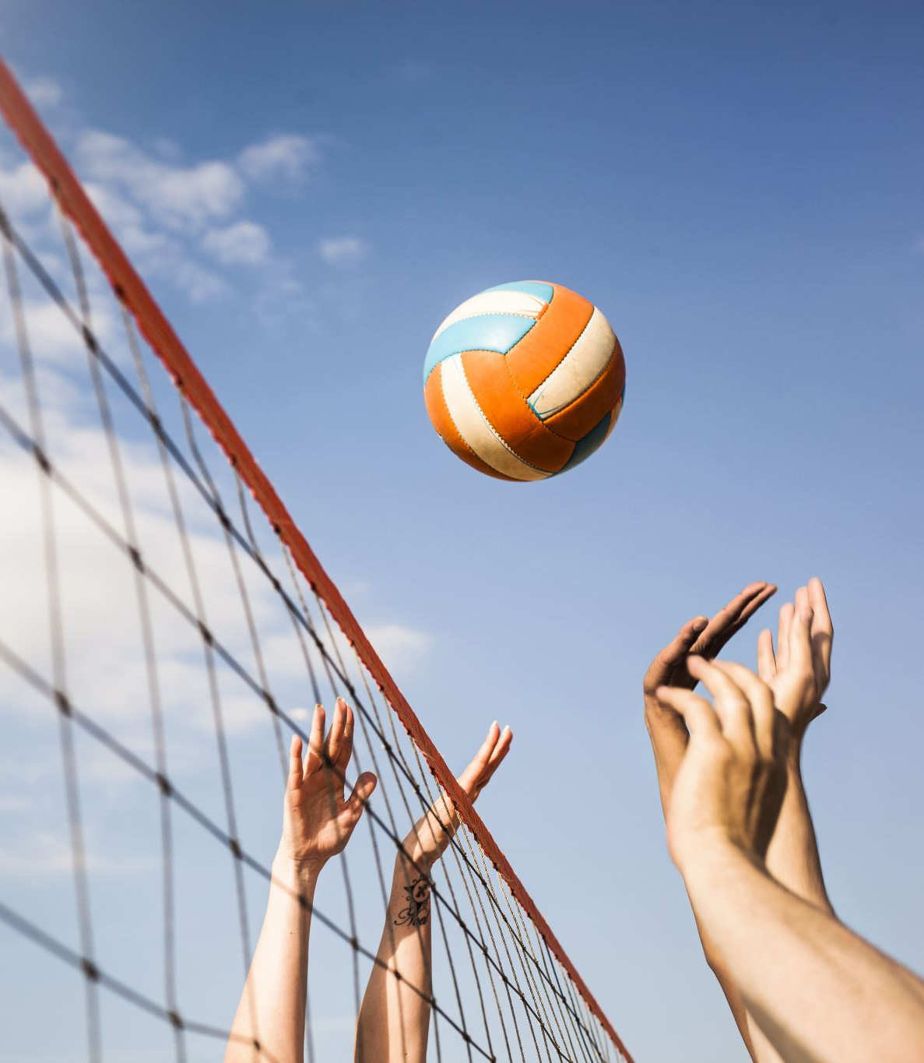
Volleyball
The first round of the children’s and youth volleyball league «Ball over the net» flew by very quickly, and now the second one! The RSUOR site in Minsk hosts 10 teams of boys born in 2010 in groups «A» and «B», and Zhlobin will also host a «wall to wall» among girls born in 2010 in groups «A» and «B». The boys born in 2012 in Gomel are completing the game week.

Slide 3
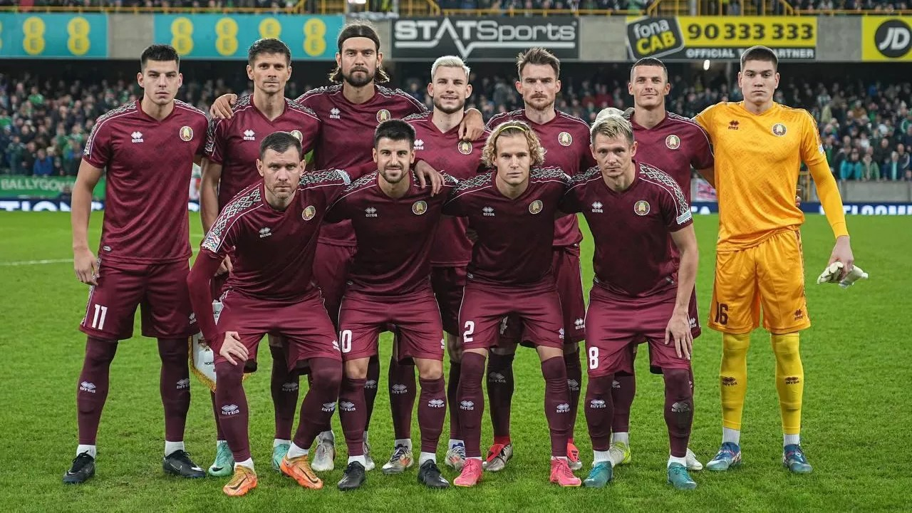
Football
The national team of Belarus will play its first international friendly match in 2025 against Tajikistan, the Belarusian Football Federation has announced.The meeting between the teams is scheduled for March 20 and is scheduled to take place at the Central Republican Stadium in Dushanbe.Before that, the national teams of Belarus and Tajikistan met once: ten years ago, Belarusians were stronger at the Borisov Arena, the game ended with a score of 6:1.Currently, in the FIFA ranking, the national team is in 98th place, the Tajik team is in 104th.

Slide 4
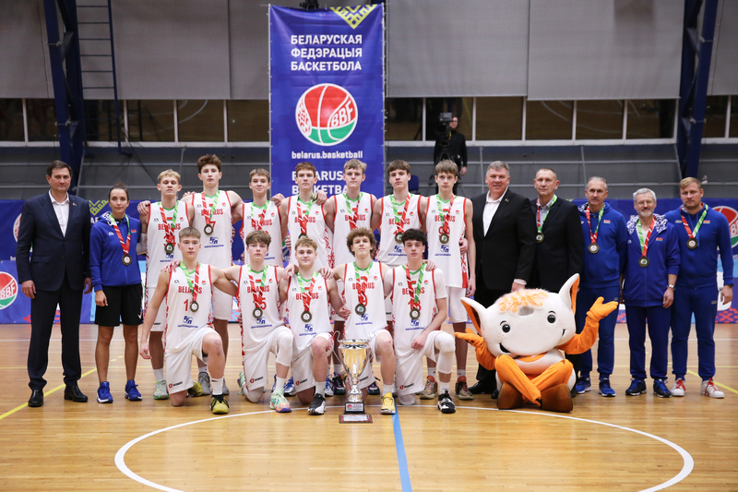
Basketball
Today, on December 8, 2024, the winners and prize-winners of the XXVII International Basketball Competitions in memory of the Minister of Sports and Tourism, first head of the National Olympic Committee of Belarus Vladimir Nikolaevich Ryzhenkov among 8 U-16 boys and girls teams from Azerbaijan, Belarus, Kyrgyzstan and Russia were determined on the basis of the capital’s RSUOR sports complex.

Slide 5
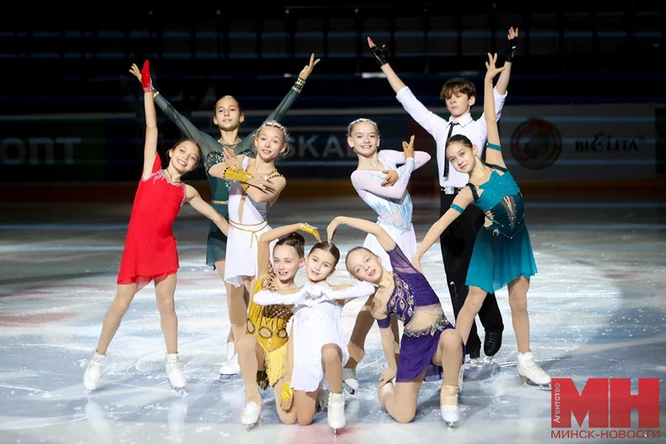
Figure skating
The audience saw the demonstration performances of the best participants of the International Figure Skating Tournament «Commonwealth Cup» on the evening of December 13 at the Chizhovka Arena, the correspondent of the Minsk-News agency reports. Athletes from Belarus and Russia demonstrated bright performances on the ice arena. The audience was delighted by the youngest participant of the tournament, a five—year-old figure skater from Belarus, who performed a program to the song «Mother Earth». Surprises awaited not only the guests of the event, but also the participants: one of the coaches of the Golden Family team proposed marriage to his colleague on the ice. This year’s tournament attracted an impressive number of participants: from December 8 to December 13, 385 athletes from Belarus, Russia, Uzbekistan and Kazakhstan took to the ice.

