Slide 1
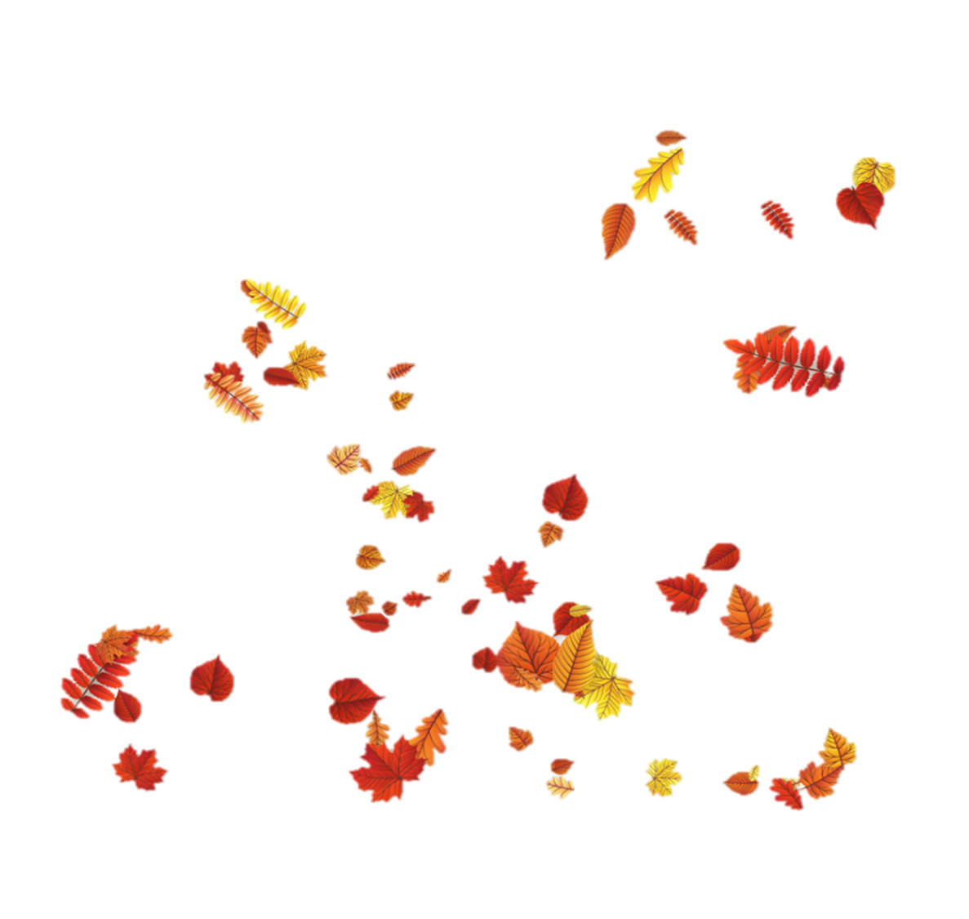
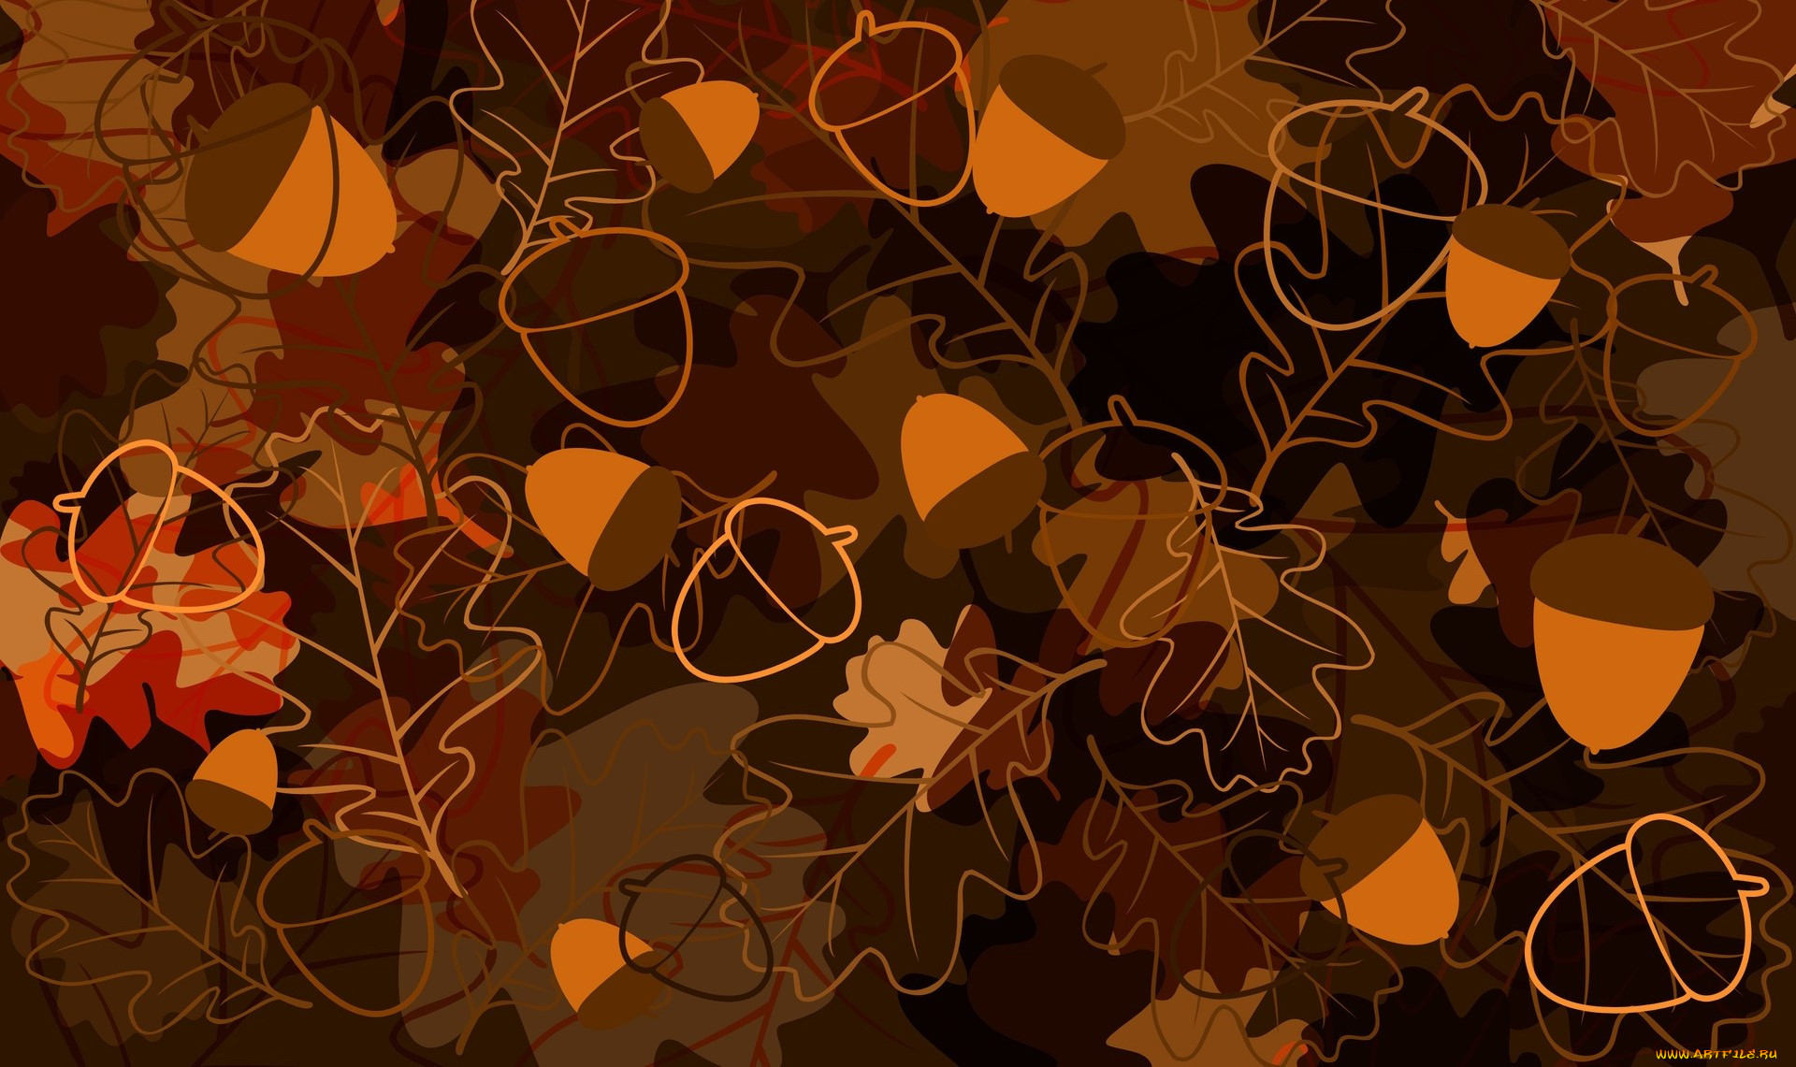
October. Scientists.

Slide 2
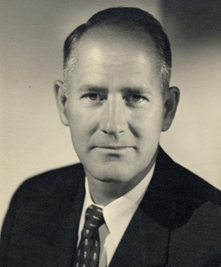
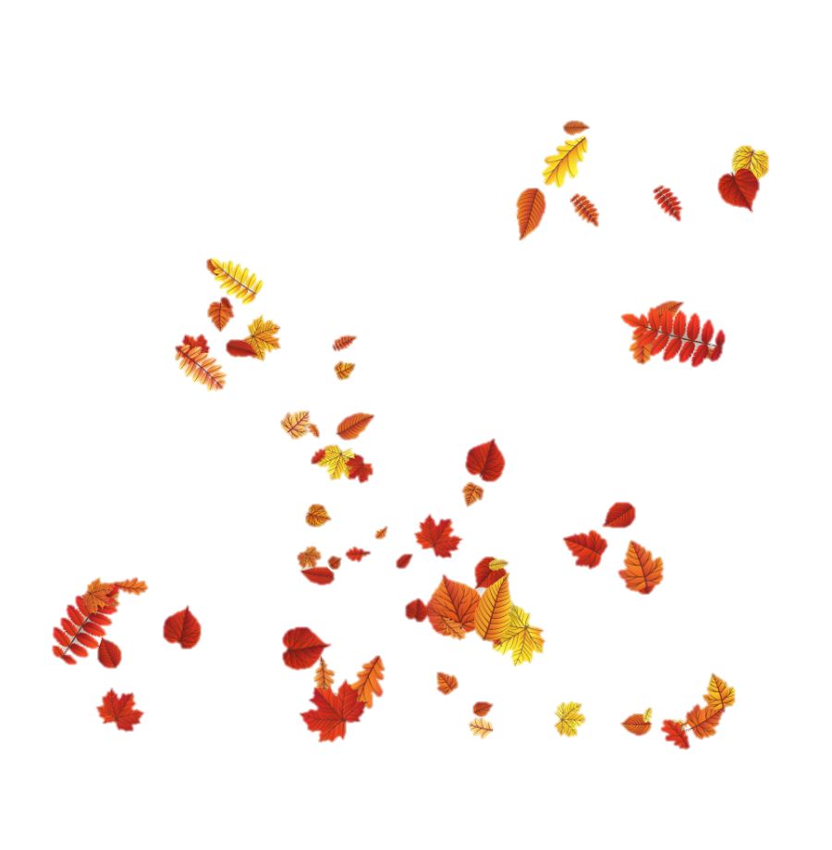
October 22, 1903 - June 9, 1989 George Wells Beadle,American biologist. He is the author of works on cytology and genetics, as well as research in the field of genetic control of metabolism, physical and chemical bases of heredity. He was awarded the Nobel Prize in Medicine (jointly with Joshua Lederberg and Edward L. Tatem) "for discoveries concerning the role of genes in specific biochemical processes" (1958).
October. Scientists.

Slide 3
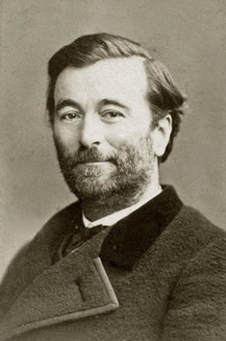
October 17, 1833 - November 11, 1886 Paul BehrFrench biologist, physiologist, Doctor of Medicine. His classic works on the physiology of respiration (1869) and the effect of barometric pressure on the body (1878) became fundamental for aviation and underwater medicine, and research on the transplantation and grafting of animal tissues was a valuable contribution to plastic surgery.
George Wells Beadle
October 22, 1903 - June 9, 1989
American biologist. He is the author of works on cytology and genetics, as well as research in the field of genetic control of metabolism, physical and chemical bases of heredity. He was awarded the Nobel Prize in Medicine (jointly with Joshua Lederberg and Edward L. Tatem) "for discoveries concerning the role of genes in specific biochemical processes" (1958).

Slide 4
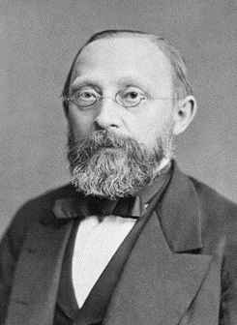
October 13, 1821 - September 5, 1902 Rudolf Virchowis a German physician, biologist, one of the founders of cell theory in biology and medicine, and the theory of cell pathology in medicine.
George Wells
October 22, 1903 - June 9, 1989
Paul BehrFrench biologist
October 17,1833 - November 11,1886
physiologist, Doctor of Medicine. His classic works on the physiology of respiration (1869) and the effect of barometric pressure on the body (1878) became fundamental for aviation and underwater medicine, and research on the transplantation and grafting of animal tissues was a valuable contribution to plastic surgery.
Beadle,American biologist. He is the author of works on cytology and genetics, as well as research in the field of genetic control of metabolism, physical and chemical bases of heredity. He was awarded the Nobel Prize in Medicine (jointly with Joshua Lederberg and Edward L. Tatem) "for discoveries concerning the role of genes in specific biochemical processes" (1958).

Slide 5
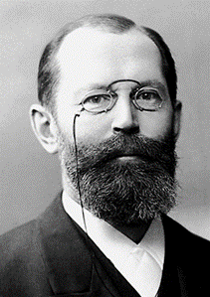
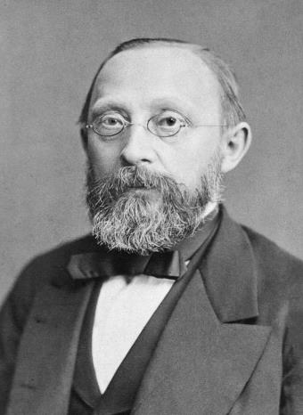
George Wells
October 22, 1903 - June 9, 1989
Paul BehrFrench biologist
October 17,1833 - November 11,1886
October 9, 1852 - July 15, 1919 Emil Hermann Fischeris a German organic chemist. He studied the structure and synthesized a number of physiologically active substances (purine derivatives): caffeine, guanine, adenine, and others. He introduced nomenclature, created a rational classification, and synthesized many carbohydrates. He was awarded the Nobel Prize in Chemistry for his work on the study of sugars and purines (1902).
Rudolf Virchowis
October 13, 1821 - September 5, 1902
Beadle,American biologist. He is the author of works on cytology and genetics, as well as research in the field of genetic control of metabolism, physical and chemical bases of heredity. He was awarded the Nobel Prize in Medicine (jointly with Joshua Lederberg and Edward L. Tatem) "for discoveries concerning the role of genes in specific biochemical processes" (1958).
German physician, biologist, one of the founders of cell theory in biology and medicine, and the theory of cell pathology in medicine.
physiologist, Doctor of Medicine. His classic works on the physiology of respiration (1869) and the effect of barometric pressure on the body (1878) became fundamental for aviation and underwater medicine, and research on the transplantation and grafting of animal tissues was a valuable contribution to plastic surgery.

Slide 6
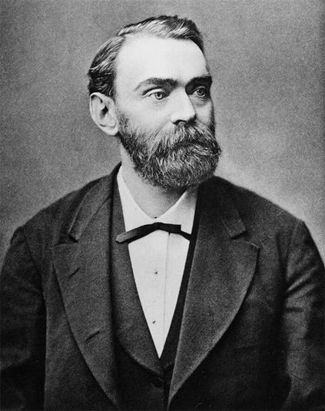
George Wells
October 22, 1903 - June 9, 1989
Paul BehrFrench biologist
October 17,1833 - November 11,1886
Emil Hermann Fischeris
October 9, 1852 - July 15, 1919
German organic chemist. He studied the structure and synthesized a number of physiologically active substances (purine derivatives): caffeine, guanine, adenine, and others. He introduced nomenclature, created a rational classification, and synthesized many carbohydrates. He was awarded the Nobel Prize in Chemistry for his work on the study of sugars and purines (1902).
Beadle,American biologist. He is the author of works on cytology and genetics, as well as research in the field of genetic control of metabolism, physical and chemical bases of heredity. He was awarded the Nobel Prize in Medicine (jointly with Joshua Lederberg and Edward L. Tatem) "for discoveries concerning the role of genes in specific biochemical processes" (1958).
physiologist, Doctor of Medicine. His classic works on the physiology of respiration (1869) and the effect of barometric pressure on the body (1878) became fundamental for aviation and underwater medicine, and research on the transplantation and grafting of animal tissues was a valuable contribution to plastic surgery.
German physician, biologist, one of the founders of cell theory in biology and medicine, and the theory of cell pathology in medicine.

Slide 7
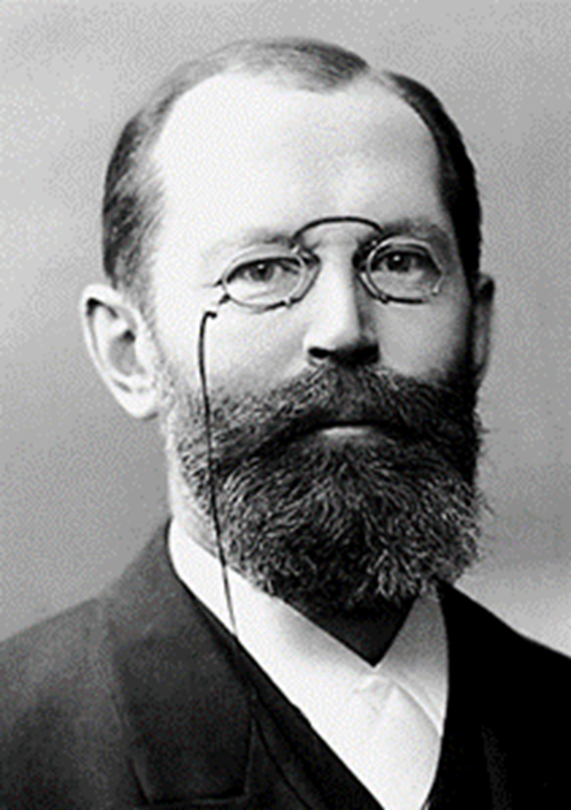
George Wells
October 22, 1903 - June 9, 1989
Paul BehrFrench biologist
October 17,1833 - November 11,1886
Alfred Bernhard Nobelis
October 21, 1833 - December 10, 1896
Swedish chemist, engineer, inventor, and entrepreneur. In 1867, he received a patent for dynamite, which he invented. In 1888, he invented dry nitroglycerin powder - ballistite. He established the Nobel Prizes, awarded for the most important achievements in physics, chemistry, medicine, literature and for contributions to the consolidation of peace.
Beadle,American biologist. He is the author of works on cytology and genetics, as well as research in the field of genetic control of metabolism, physical and chemical bases of heredity. He was awarded the Nobel Prize in Medicine (jointly with Joshua Lederberg and Edward L. Tatem) "for discoveries concerning the role of genes in specific biochemical processes" (1958).
physiologist, Doctor of Medicine. His classic works on the physiology of respiration (1869) and the effect of barometric pressure on the body (1878) became fundamental for aviation and underwater medicine, and research on the transplantation and grafting of animal tissues was a valuable contribution to plastic surgery.
Emil Hermann Fischeris
October 9, 1852 - July 15, 1919
German organic chemist. He studied the structure and synthesized a number of physiologically active substances (purine derivatives): caffeine, guanine, adenine, and others. He introduced nomenclature, created a rational classification, and synthesized many carbohydrates. He was awarded the Nobel Prize in Chemistry for his work on the study of sugars and purines (1902).

