Slide 1
The World
March holidays

Slide 2
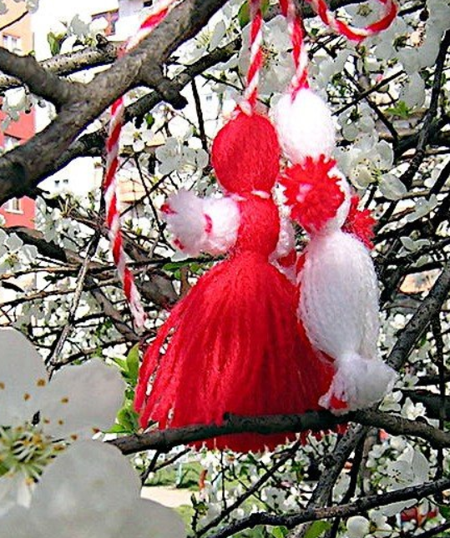
Baba Marta Day, March 1
Baba Marta Day is celebrated in Bulgaria to encourage spring to begin. In a centuries-old tradition, people exchange and wear Martenitsas, pairs of red and white tassels. They symbolize the dual nature of Baba Marta (Grandmother Martha), the bringer of spring. The Martenitsa will guard against evil. It’s worn until a stork or a blossoming tree is seen. Then the Martenitsa is taken off and hung on a tree.
Though the exact origin of the red and white colors are unknown, it’s though that red stands for life or birth and white for anew. Together, they symbolize rebirth. Popular thought is that red means good health and white means innocence and joy.

Slide 3
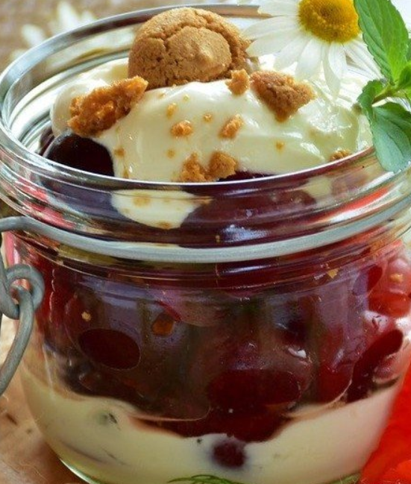
National Fruit Compote Day, March 1
March 1 is National Fruit Compote Day. Compote, French for mixture, has been around since the 17th century. Created in France, this simple dessert is whole or chopped pieces of fruit cooked in a sugar syrup. The syrup is often flavored with vanilla, citrus peel, or spices. Candied fruit and raisins might also be added. Compote may be served warm or cold. The French invented compote believing it would balance the effects of humidity on the body. It’s not very humid in most parts of the US in March, but warm apple compote is a wonderful winter treat.

Slide 4
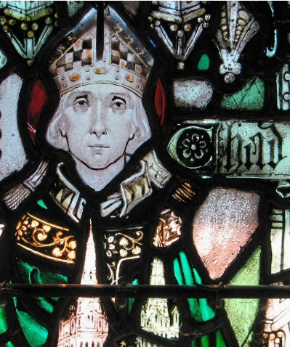
Ceadda's Day, March 2
Ceadda's Day honors two Ceaddas. One is for the feast day of St. Chad, Chad of Mercia, who was a prominent 7th century Anglo-Saxon churchman. He became abbot of several monasteries, Bishop of the Northumbrians, and subsequently Bishop of the Mercians and Lindsey People. He is also credited with the Christianization of the ancient kingdom of Mercia. St. Chad is the patron saint of Mercia, Lichfield, and of astronomers. On this day it’s considered the most propitious day to sow broad beans in England.
The second is for the Celtic god of healing springs and holy wells. Ceadda is associated with the Crann Bethadh or the Tree of Life. Ceadda spent nights immersed in a holy well to meditate.
Both of these Ceadda days are on March 2nd. It’s possible there’s a connection between the two days with the Christianizing of pagan celebrations.
Chad is a masculine given name of Anglo-Saxon origins. It’s the modernized form of the Old English given name Ceadda.

Slide 5
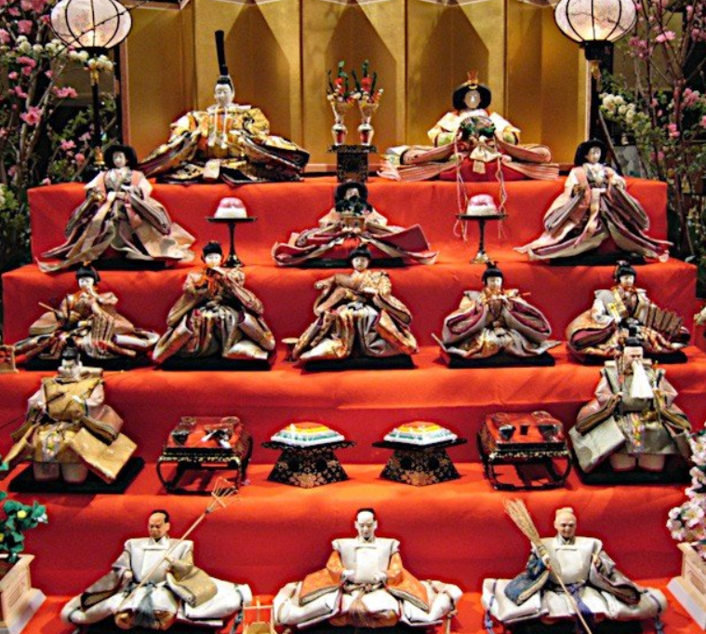
Hina Matsuri, March 3
Hina Matsuri (Hinamatsuri) is the Japanese Doll’s Festival. It’s also known as Momo-no-Sekku, the Peach Blossom Festival. This holiday used to follow the Lunar Calendar and fell closer to April when peach blossoms began to bloom. Though the trees no longer bloom during the festival, the peach blossoms are still an important decoration for this celebration.
The festival stems from the Heian period when people believed the dolls possessed the power to contain bad spirits. During a custom called hina-nagashi (doll floating), straw hina dolls in miniature boats were set adrift on the river to be taken out to sea, taking misery and hardships with them. The Shimogamo Shrine in Kyoto still floats dolls on straw mats down the stream that runs through the temple grounds and prays for the safety of children.
Families with young daughters celebrate with an elaborate platform of ceremonial dolls to ensure their daughter’s future happiness. This dates to a time when happiness came from being married. Girls often invite their friends over to celebrate together.

Slide 6
National Grammar Day, March 4
National Grammar Day was created in 2008 by Martha Brockenbrough, founder of the Society for the Promotion of Good Grammar and author of Things That Make Us [Sic]. Brockenbrough states that, “Language is something to be celebrated, and March 4 is the perfect day to do it. It’s not only a date, it’s an imperative: March forth on March 4 to speak well, write well, and help others do the same!"
Grammar is the whole system and structure of a language including syntax, morphology, phonology, and semantics.
Brush up on your grammar today. Review a memo or letter you wrote last week and see if you have any grammar mistakes.

Slide 7
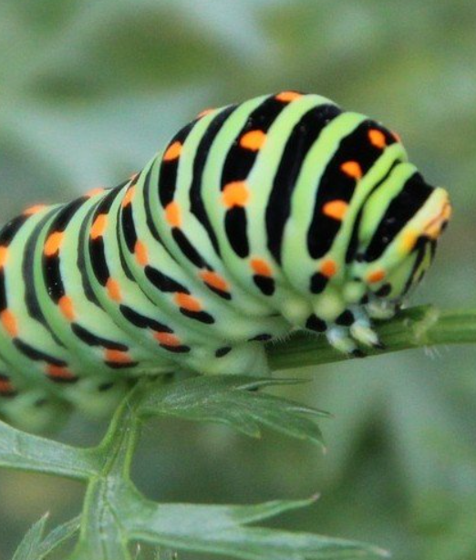
Feast of Excited Insects, March 5
The Feast of Excited Insects announces the arrival of spring. It’s known as Ching Che in China and Kyongchip in Korea. Insects awake from their winter hibernation on or close to March 5th.
In China the dragon raises its head, waking all the insects from their slumber. Offerings of millet meal and bean cake are laid under trees as offerings. Sometimes decorations are put out to calm the more excited bugs. Incense if burned as an offering to the gods. In Korea, farmers prepare their fields and begin planting. Flowers are left on the graves of ancestors in hope of bountiful groups.
It’s also a time to visit a "devil-beater" and curse bad people and bad times. People purchase incense sticks and yellow paper tigers. They write the name of the bad person the paper and pay a woman to beat it with a shoe. This curses the bad people and times. More often than cursing they pray for good health and good luck.

Slide 8
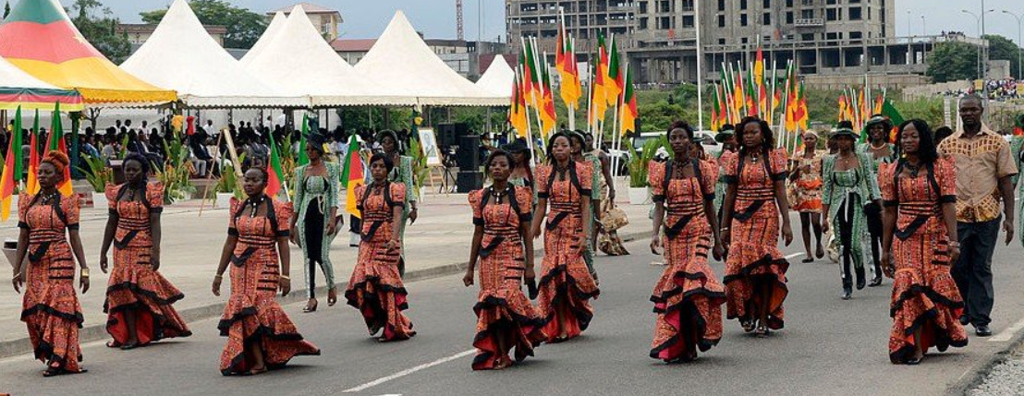
International Women's Day, March 8
International Women's Day (IWD) commemorates the movement for women's rights. The earliest observance was February 28, 1909 in New York when organized by the Socialist Party of America. On March 8, 1917, in Saint Petersburg, Russia, women held demonstrations all over the city for bread and peace. This was the beginning of the Russian Revolution. Seven days later, the Emperor of Russia, Nicholas II abdicated and the provisional Government granted women the right to vote. March 8 was declared a national holiday in Soviet Russia in 1917. The day was predominantly celebrated by the socialist movement and communist countries until it was adopted in 1975 by the United Nations.
The day is an official holiday in many countries. In Russia, the day has lost the political context and now is a day to honor women.

Slide 9
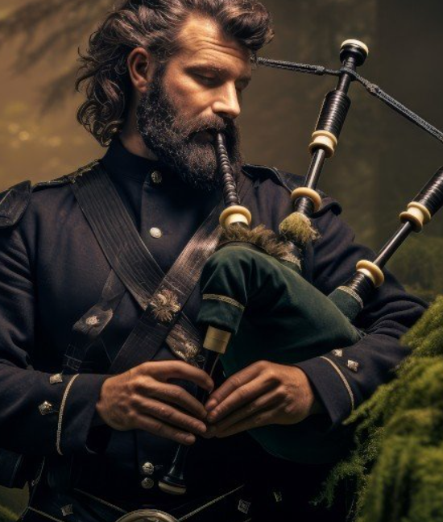
International Bagpipe Day, March 10
International Bagpipe Day is celebrated on March 10th. It was created by The Bagpipe Society in 2012 to celebrate the world’s bagpipes and piping traditions. Pipers are invited to play and participate in local events, talks, and gathering.
Pipers refer to bagpipes as "the pipes," "a set of pipes," and "a stand of pipes."
Bagpipes are woodwind instruments using enclosed reeds fed from a constant reservoir of air in the form of a bag. Though the Scottish Great Highland bagpipes are the best known, bagpipes have been played for a millennium or more throughout large parts of Europe, northern Africa, and western Asia, including Turkey, the Caucasus, and around the Persian Gulf. There are over 130 types of bagpipes.
According to the Oxford History of Music, a sculpture of bagpipes was found on a Hittite slab at Euyuk in the Middle East, dated to 1000 BCE.

Slide 10
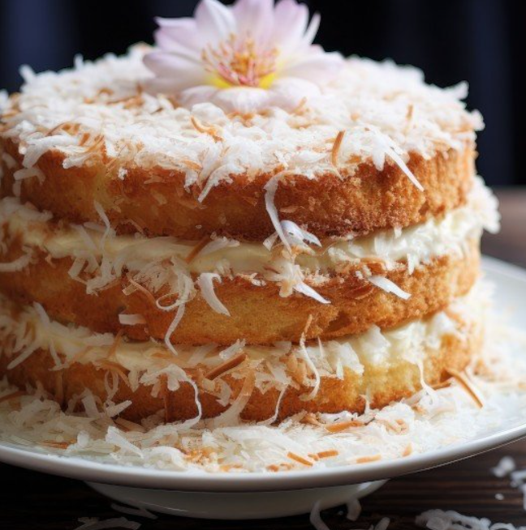
National Coconut Torte Day, March 13
National Coconut Torte Day is on March 13th. A coconut torte has layers of rich, dense cake with a creamy filling, all flavored with coconut and topped with shredded coconut. Coconut lovers rejoice.

Slide 11
National Panda Day, March 16
National Panda Day was created to bring awareness to the plight of the panda. Pandas or Giant Pandas are a bear native to south central China.
The giant panda, also known as the panda bear or simply panda, is characterized by large, black patches around its eyes, over the ears, and across its round body. The panda is a folivore—bamboo shoots and leaves make up more than 99% of its diet. They are often referred to as giant pandas to distinguish them from red pandas (a mustelid).
As of this 2017, they were classified as a vulnerable species on the IUCN (Red List of Threatened Species), meaning they’re at high risk of extinction without further human intervention. They are also on the endangered list on the ESA (Endangered Species Act), which means they’re at risk of extinction in the wild.
China is fighting to preserve these animals by providing them with a safe place to live and grow.

Slide 12
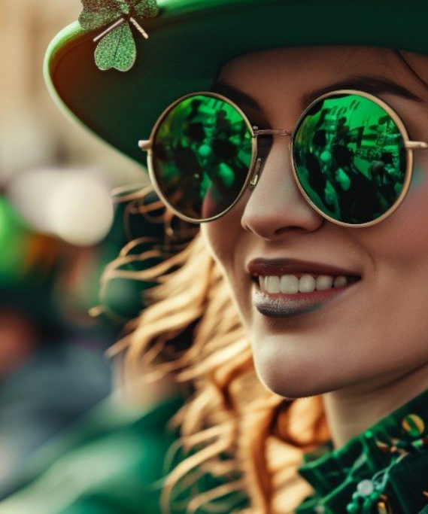
St. Patrick’s Day, March 17
St. Patrick’s Day is celebrated everywhere on March 17th by both Irish and non-Irish people. Parades, the wearing o’ the green, and an Irish feast are all customary on this day. A typical American favorite “Irish” dinner is corned beef & cabbage. Another favorite meal is one that is all green, food that is naturally green and food that is tinted green with food coloring. This day is celebrated with parties, wearing green, consuming beer, and a whole lot of fun in America.
Cities do it up for St. Patrick’s Day too. In Dublin, the Greening of the City lights up iconic buildings in a green hue. In London, there’s a mile-long parade. New York has the oldest and biggest St. Patrick’s Day parade in the US. Chicago turns the Chicago River Green, using over 40 lbs. of green dye.Boston holds a large parade and the most of the cities plentiful Irish bars have specials.

Slide 13
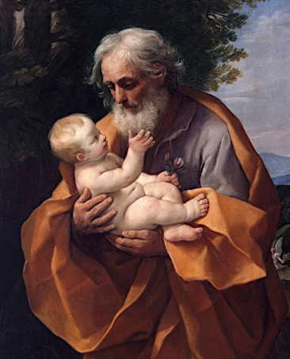
St. Joseph's Day, March 19
Western Christianity celebrates Saint Joseph's Day, the Feast of St. Joseph, Solemnity of Saint Joseph, La Festa di San Giuseppe in Italy, and Jum San Ġużepp in Malta on March 19. Saint Joseph was the spouse of the Blessed Virgin Mary.
This is the also the feast day for persons named Joseph or derivatives of Joseph as well as for schools and parishes names after St. Joseph, and for carpenters.
An altar, in three tiers symbolizing the Holy Trinity, displays a statue of St. Joseph, candles, fava beans, breads and pastries, baskets, lilies and other flowers, carpentry tools, pineapple (symbolizing hospitality), lemons or limes (for luck), bread and wine symbolizing the Last Supper.
St. Joseph's Day is a big feast day for Italians. According to legend, during the Middle Ages, St. Joseph saved the Sicilians from a famine, which was caused by a serious drought, by bringing rain. The fava bean crops saved the people from starving. Foods traditionally served are fava beans, foods with breadcrumbs (which represent sawdust), and zeppole (cream filled pastries with a cherry on top). Wearing red is also customary.
In Spain, this is Father's Day, referring to St. Joseph. In Valencia, Falles is celebrated. The term Falles refers to both the celebration and the monuments created during the celebration.

Slide 14
International Colour Day, March 21
International Colour Day was proposed in 2008 by the Portuguese Color Association to the International Colour Association. It was accepted in 2009 since color is an influential phenomenon in most people’s lives. It’s celebrated on March 21st to coincide with the vernal equinox, a day of equal light and dark, symbolically complementary.
Activities and events on International Colour Day include arts exhibitions, architectural projects, design, and fashion. There are also color and light workshops and contests. People are encouraged to wear their national or regional colors.
The logo was designed by Hosanna Yau, from Hong Kong, the winner of an international competition in 2012. Yau explained the design as "two circles form an eye, with an equal half of rainbow color and black representing light and darkness, day and night, everyone feast one's eye on the international color day."

Slide 15
World Water Day, March 22
World Water Day was declared by the United Nations (UN) in 1993 to focus attention on the importance of universal access to clean water, sanitation, and hygiene (WASH) facilities in developing countries. The day also advocates for the sustainable management of freshwater resources. According to the UN, there are 2.2 billion people living without access to safe water.
World Water Day is celebrated around the world with a variety of events. A theme is selected each year.

Slide 16
Waffle Day | Våffeldagen, March 25
Waffle Day or Våffeldagen is celebrated in Sweden by eating waffles. The name comes from Vårfrudagen ("Our Lady's Day"), which in vernacular Swedish sounds almost like Våffeldagen (waffle day). Our Lady's Day, the Christian holiday of Annunciation, is also celebrated on March 25. However, Waffle Day has no religious connections, it’s just about the waffles. They are usually heart-shaped and topped with whipped cream and jam or fresh berries and served with coffee. Swedish waffles are not made with yeast (like Belgium waffles), which makes them thinner.

Slide 17
Borrowed Days, March 29-31
March 29th, 30th, and 31st are Borrowed Days in the Scottish Highlands. The last days of March tend to have bad weather giving rise to the notion that they are “borrowed” from April. An old Scottish rhyme explains that the last three days were borrowed from April. In return March would destroy a group of young sheep. But due to bad weather, March did not fulfill its end of the deal.
March said to Aperill,
I see three hoggs'' upon a hill,
And if you'll lend me dayes three,
I'll find a way to make them dee.
The first o' them was wind and weet,
The second o' them was snaw and sleet,
The third o' them was sic a freeze,
It froze the birds' nebs to the trees:
When the three days were past and gave,
The three silly hoggs came hirpling' hame.
Other references to the Borrowed Days go back to an ancient calendar of the Church of Rome and a 1548 book known as the Complaynt of Scotland. They suggest the end of March feels and acts more like April.

