Slide 1
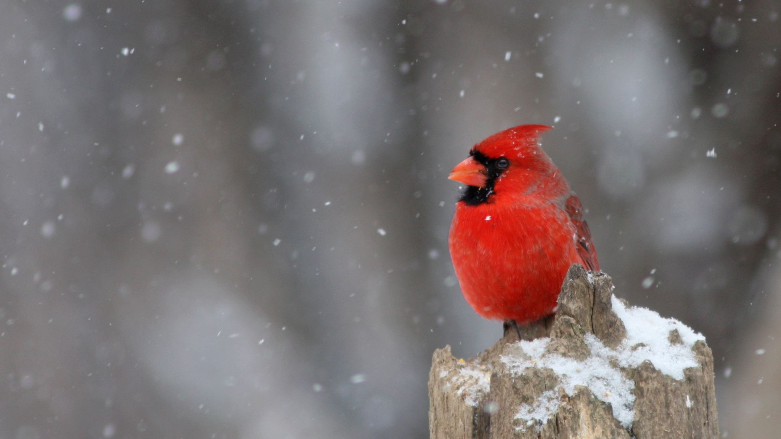
December
Forestry News for December

Slide 2
New Year's Eve Children's Matinee
A New Year’s performance was organized in the ice arena for the children of forestry workers. Boys and girls greeted fairy-tale characters right on the ice with great pleasure and smiles on their faces. Ice skating, songs, dances, round dances – everything for our children on the eve of the New Year holidays.

Slide 3
Christmas Tree Market
The demand for New Year’s trees is growing on the eve of the New Year holidays. Santa Claus and the Snow Maiden of the Luninets forestry create a New Year’s mood for customers. Residents of Luninets accept congratulations on the upcoming New Year and Christmas, treat them with pancakes and tea.

Slide 4
Forestry New Year Celebrations
Chief forester Viktor Semenovich Konopatsky, deputy head of the organization for ideological work Elena Vladimirovna Merzlaya, forester of the Dyatlovichsky forestry Vladimir Vasilyevich Maslovsky visited the preschool forestry “Ekolyata”. We congratulated the young preschool children on the upcoming New Year and Merry Christmas. Prosperity, peace, kindness, health, fulfillment of your most cherished desires, dear guys!

Slide 5
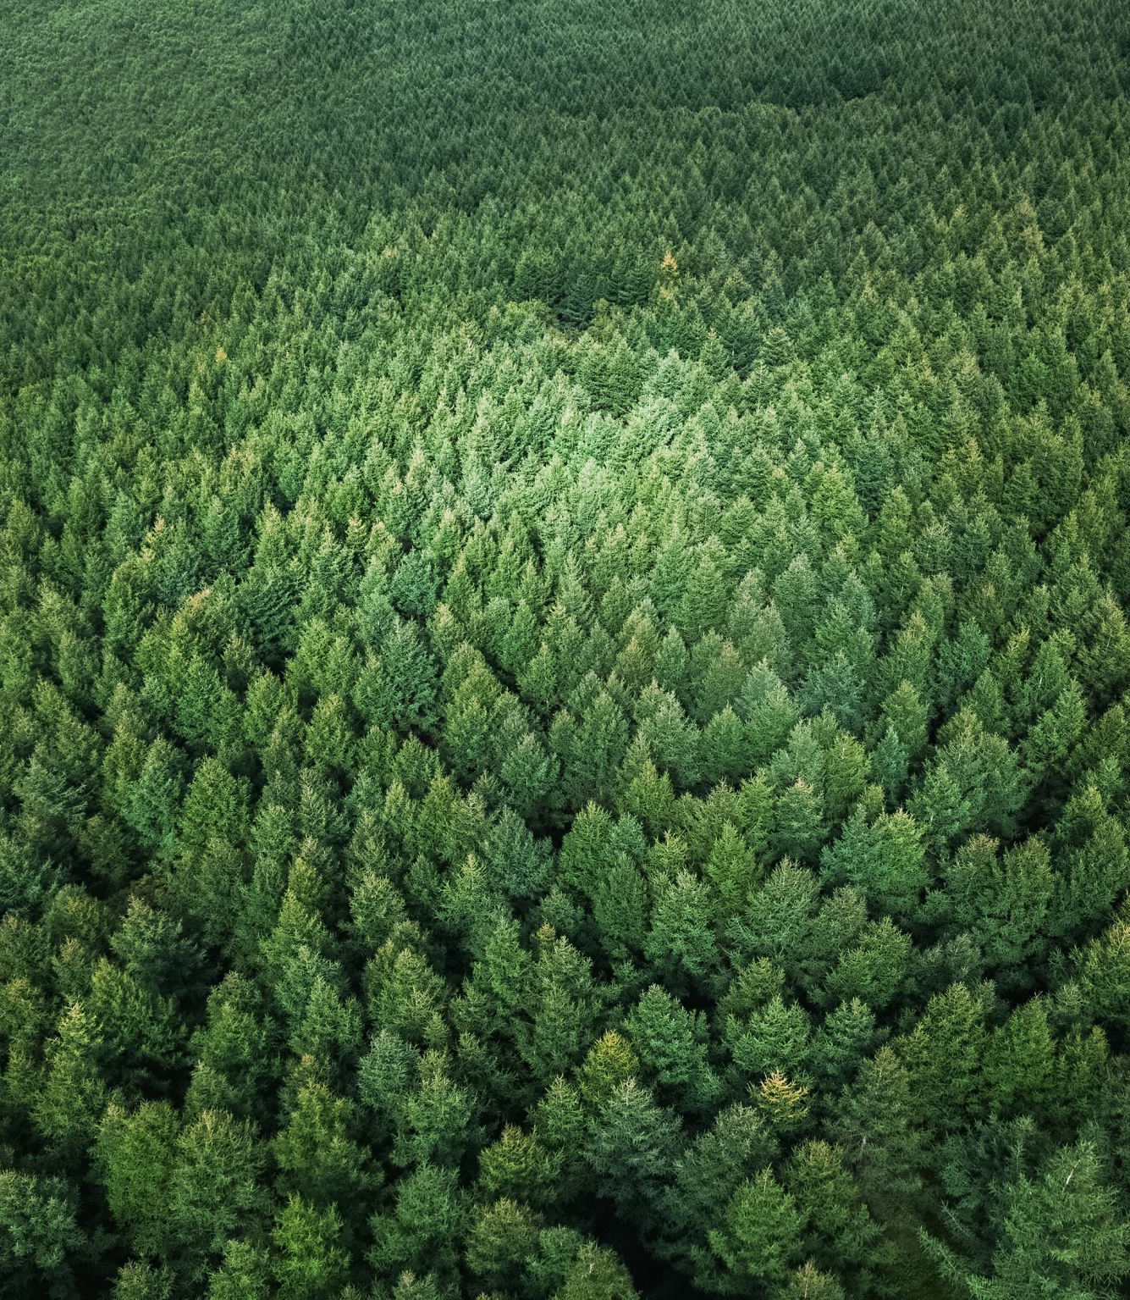
Careful attitude towards national wealth is under state control
Minister of Forestry Alexander Kulik spoke at a meeting of the Council for Interaction of Local Government Bodies under the Council of the Republic Rational use of natural resources, inexhaustible forest management, environmental protection have been and remain priority areas of state policy of the Republic of Belarus. How to not only preserve but also increase these achievements was discussed on December 6 in Brest at an off-site meeting of the Council for Interaction of Local Government Bodies under the Council of the Republic under the leadership of the Chairman of the Council of the Republic Natalya Kochanova.

Slide 6
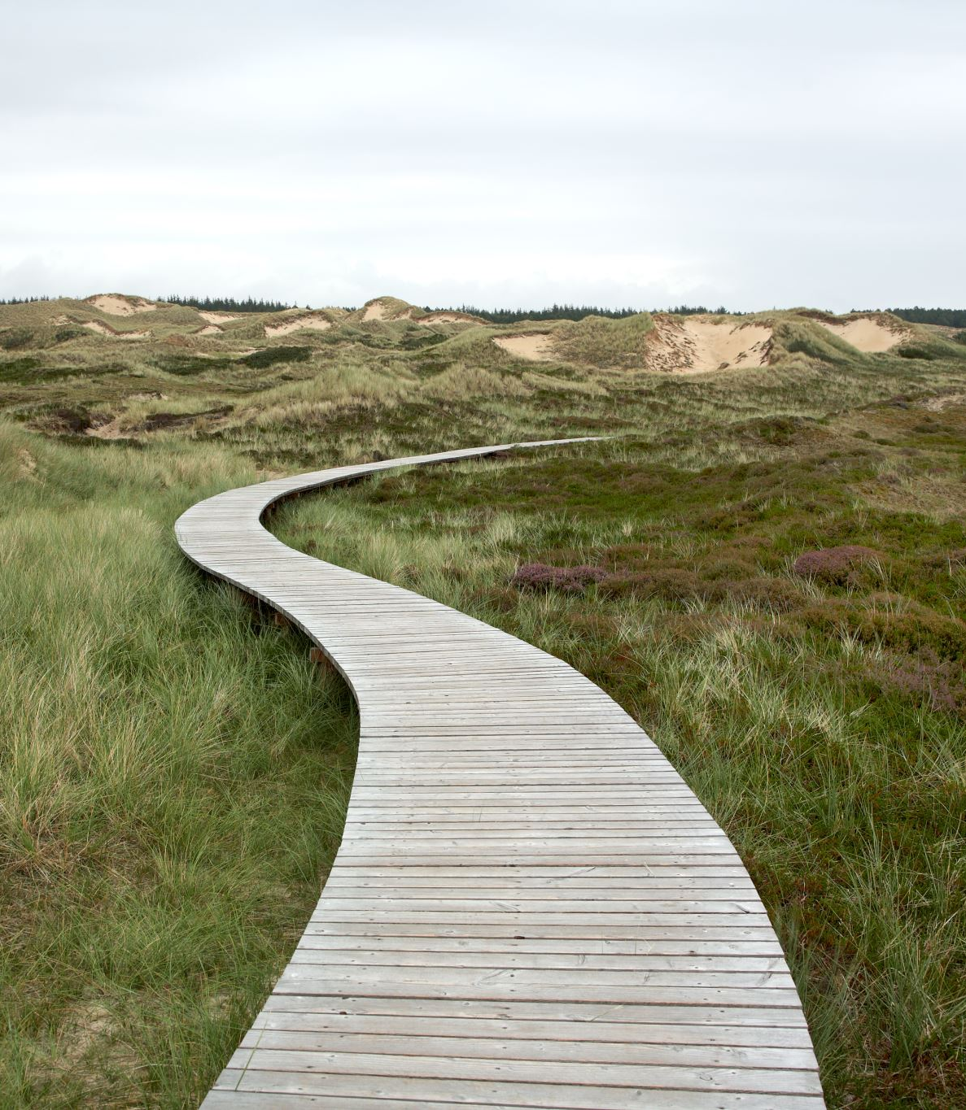
The role of local authorities in compliance with the environmental agenda
The event was based on the bright speech of the President of Belarus Alexander Lukashenko on December 1 at the plenary session of the World Climate Action Summit. The Brest region was not chosen by chance to host the Council meeting, because it is the center of Belarusian Polesie. Here they preserve the natural state of specially protected natural areas, on which the formation of Europe’s climate directly depends, successfully develop a network of “green schools”, restore order on the earth, build and reconstruct wastewater treatment facilities and much more.

