Slide 1
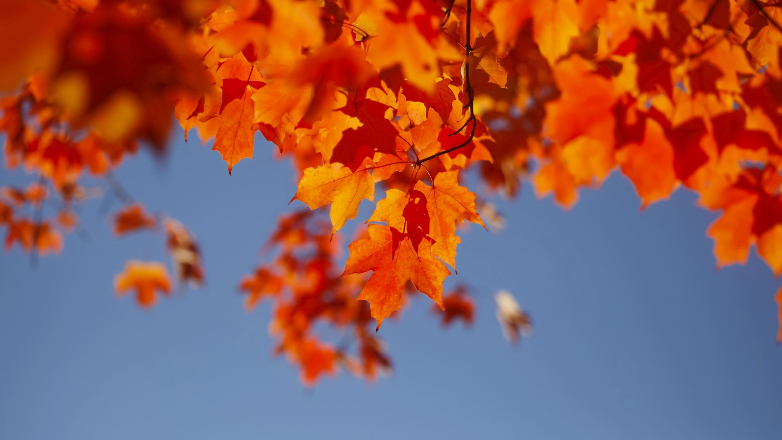
October
News for October

Slide 2
RESEARCH DIPLOMAS AWARDED AT GSU
On October 30, the awarding of research diplomas took place at the Francysk Skaryna Gomel State University. It should be noted that among the graduates there is 1 doctoral student, and also one graduate is a citizen of Turkmenistan

Slide 3
VIDEO CONFERENCES WITH THE MOSCOW STATE ACADEMY OF PHYSICAL EDUCATION AND THE EAST SIBERIAN INSTITUTE OF THE MIA OF RUSSIA
On October 26-27, the Department of Theory and Methodology of Physical Culture of the Gomel State University named after F. Skorina acted as a co-organizer and active participant in the III All-Russian Scientific Conference with international participation “Modern trends in psychological and pedagogical support for those involved in physical culture and sports” (Malakhovka, Russia) and the International Scientific and Practical Conference “Improving the professional and physical training of cadets, students of educational organizations and law enforcement officers” (Irkutsk, Russia)

Slide 4
NEW HORIZONS FOR IMPLEMENTING OPPORTUNITIES
A meeting-seminar with employees of MODSEN OJSC (https://www.modsen-software.com/) was held at Gomel State University named after Francis Skaryna. The Modsen company was represented by: Terentyev Gleb – CEO; Evgeniy Kalugin – service station; Krivel Marina – head of the JS department; Grishanovich Dmitry – head of the Net department; Ivanova Yulia – head of the HR department; Svetlana Krivko – internship coordinator
The seminar was attended by teachers, graduate students of the Faculty of Physics and Information Technology, the Faculty of Mathematics and Programming Technologies.

Slide 5
COMPETITION “COME ON, FRESHMAN!” WENT TO GSU FOR THE 49TH TIME!
The most long-awaited creative event of the fall took place at GSU – the competition “Come on, freshman!” For two days, an indescribable atmosphere reigned in the assembly hall, and emotions simply went off scale. Yesterday’s schoolchildren did what seemed incredible to them – they took the stage at GSU and took part in a large-scale event.
This year the competition was held for the 49th time! The common theme of all speeches is “The Story of Unlost Time.” First-year students from 11 faculties lit up the hall with sparkling humor, amazed with bright choreographic and vocal numbers, and surprised with creative miniatures. Each team presented on stage their unique vision of the plots of classic fairy tales, feature films and children’s cartoons. Viewers were able to plunge into the atmosphere of the Jumanji game, feel like a guest at Alice’s tea party, and watch the adventures of Puss in Boots

Slide 6
Komsomol is 105 YEARS OLD!
Rector of the Francysk Skorina State University Sergei Khakhomov took part in the ceremonial meeting dedicated to the 105th anniversary of the All-Union Lenin Communist Youth Union and the 60th anniversary of the Belarusian student groups

Slide 7
26TH INTERNATIONAL EXHIBITION OF TECHNOLOGIES AND INNOVATIONS IN INDUSTRY «TEKHINNOPROM»
F. Skorina State University took part in the 26th international exhibition of technologies and innovations in industry “TEKHINNOPROM”. Scientific developments of our university in the field of microelectronics were presented by researchers from the problem research laboratory Alexander Mayevsky and Konstantin Danilchenko. Vice-Rector for Research Dmitry Kovalenko and Head of the Department of Optics Vladimir Gaishun held negotiations on cooperation and signed several protocols of intent: with the Federal State Budgetary Educational Institution of Higher Education «Kuban State University» on the development of partnership and interaction in the scientific and technological sphere, the field of cyber security, personnel training, exchange of experience; with NUST MISIS – on the implementation of joint research and cooperation in the field of solar energy, new materials; with the State Research and Production Association “Optics, optoelectronics and laser technology” – on the development of new composite materials, research in the field of laser technology, photovoltaics, optics, etc.

