Slide 1
Famous lawyers in British history
The world

Slide 2
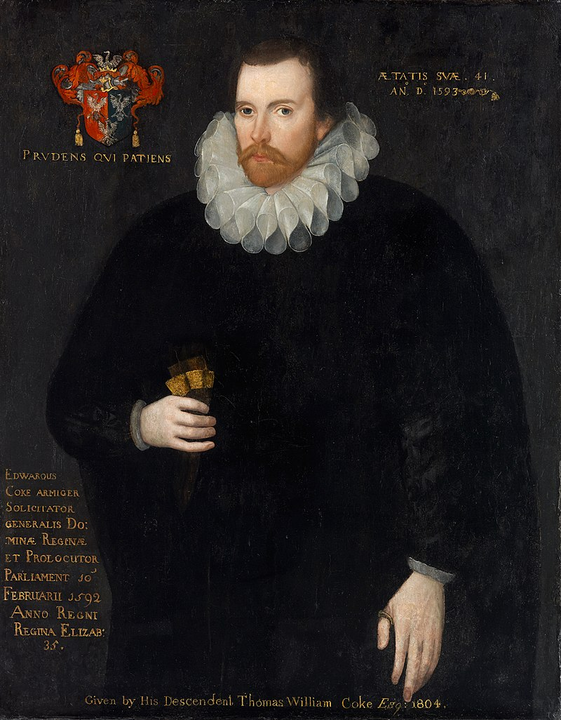
England
Edward Coke (1552 - 1634)
He was an English politician and the most famous lawyer of the reign of Queen Elizabeth I. Lord Chief Justice of England, Solicitor General of England.
As a lawyer, he took part in many well-known trials of this time, which allowed him to work in Parliament as a Speaker of the House of Commons.
As a crown lawyer, Coke gained an unfavorable reputation for his imperious, rude and extremely harsh treatment. On the other hand, Coke showed a great independence, resolutely rebelling against any violations of the law and vigorously protecting the principles of legality. This independence was the reason for the deprivation of all his posts in 1616 by King James I. However, in 1620, Coke was again elected as a member of parliament and became one of the main figures of the opposition during the following years.
He devoted the last years of his life to the revision and correction of his legal treatises. They were important for the development of English law literature and are still the main works in the study of various aspects of English law.

Slide 3
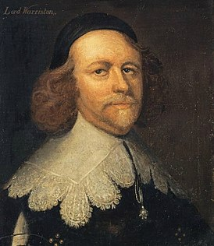
Scotland
Archibald Johnston (1611 – 1663)
He was an outstanding lawyer. He became the author of the "National Covenant, the manifesto of the Scottish national movement in defense of the Presbyterian faith".
Johnston was the leader of the ultra-protestant wing. At the end of 1638, he came up with a rather radical idea of the complete elimination of the episcopal system in the Presbyterian church. Johnston was able to pass an act on the liquidation of the episcopate through the General Assembly of the Church of Scotland, which led to a war between the Scots and the king.
During the English Revolution of 1641-1660 Johnston actively supported Oliver Cromwell, and also joined the Committee of Both kingdoms and coordinated the actions of parliamentary troops against the royalists.
After the Stuart Restoration in 1660, Johnston was forced to flee the country. In 1663 Johnston was captured and then hanged in Edinburgh.

Slide 4
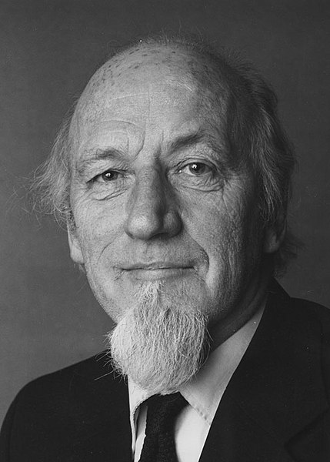
Wales
John Aneurin Grey Griffith (1918 - 2010)
A well-known legal scholar not only in Wales, but also in the UK in general.
He worked as a Professor of English Law from 1959 to 1970. Then he was a Professor of Public Law from 1970 till his retirement in 1984, becoming Professor Emeritus of Public Law. After retirement, he was elected as a Rector of the University of Manchester. This position he held for seven years. He was elected as a member of the British Academy in 1977.
Griffith's legal works contained more realistic accounts of what was really going on. Griffith also made a radical criticism of the role of the judiciary, especially when it invades the sphere of politics. He believed that the idea of the rule of law was a fantasy invented by liberals in the late 19th century.
In 1977 in the review of Griffith's work, it was argued that every criminal trial is categorically unfair. Subsequently, this book became a bestseller.

Slide 5
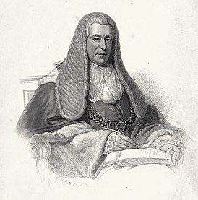
Ireland
Thomas Langlois Lefroy (1776 – 1869)
Irish politician and judge.
He came from a family of French Huguenots.
He was elected to the House of Commons for the Dublin University seat in 1830 as a Tory and became a member of the Privy Council of Ireland on January 29th, 1835. Lefroy continued to represent the University until he was appointed an Irish judge with the title of Baron of the Exchequer in 1841. He was appointed Chief Justice of the Court of Queen's Bench in Ireland in1852 despite some accusations in Parliament that he was too old to do the job.
Lefroy did not resign as chief justice until he was 90.

