Slide 1
THE WORLD
FIVE OF SCOTLAND YARD'S MOST HIGH-PROFILE INVESTIGATIONS
On September 29, 1829, a civilian police force was established in London, called Scotland Yard. For 184 years, this department has been fighting crime in England. We bring to your attention several well-known Scotland Yard investigations

Slide 2
THE LATE-NIGHT MURDER AT THE ROAD HILL HOUSE
The investigation began on July 15, 1860. Two weeks earlier, on June 29, a three-year-old child was found murdered at the Road Hill House Villa. He was the youngest son of factory inspector Samuel Kent, who lived there with his second wife, three children from his first marriage and three children from his second marriage. The murdered boy named Savile was a son from his second marriage, a favorite of his father and mother. At night Savile disappeared from his crib. He was found in the garden lavatory with his throat cut. Criminology as a science did not exist at that time, and in the arsenal of Scotland Yard Inspector Jonathan Whicher was only his observation, knowledge of people and the ability to think logically. In four days, he came to the conclusion that only one person could have committed the crime: Kent's sixteen-year-old daughter Constance, a child from his first marriage. Constance hated her stepmother. Whicher believed that she had killed her stepbrother, her mother's favorite, to get revenge on her. The crime, he believed, could hardly have happened without leaving traces on the girl's clothes. When the inspector found that one of Constance's nightgowns had disappeared, he demanded her arrest, but caused public indignation. Victorian morality did not allow a child to be accused of murdering his helpless brother. Inspector Whicher was fired from his job to protect the police from attacks. And four years later Constance Kent confessed to the crime herself: she really killed her brother to get revenge on her parents.
Inspector Jonathan Whicher, although he was able to solve the crime, but under public pressure, the culprit was not punished.

Slide 3
MURDER ON THE RAILROAD
On July 9, 1864, in a compartment of the North London Railway, an unknown person killed and threw a 70-year-old bank employee out of the train on the move. The criminal took from the murdered man a gold watch with a chain, gold-rimmed glasses and, very strangely, a hat. He left his hat in the compartment. Only 11 days later, detective Dick Tanner managed to find a jeweler, from whom the killer exchanged a watch with a chain for another watch. The box in which the exchanged watches were packed led the Scotland Yard inspector on the trail of a German tailor named Franz Muller, who lived in London. The hat found at the crime scene turned out to be a tailor, and from his letter to the housewife it became clear that he sailed to North America aboard the sailing ship Victoria. A persistent detective organized a chase for the fugitive: together with several witnesses, he went on the trail of the escaped murderer on the City of Manchester steamboat. I arrived in New York 14 days before the escaped criminal. Eyewitnesses of this event recall that when a sailboat appeared in the port, on which the fugitive was, a boat with curious people sailed towards him, who shouted: "How are you, killer Muller?.." On September 16, Tanner brought the arrested man to England, and two months later Muller, who confessed to the crime, was hanged.

Slide 4
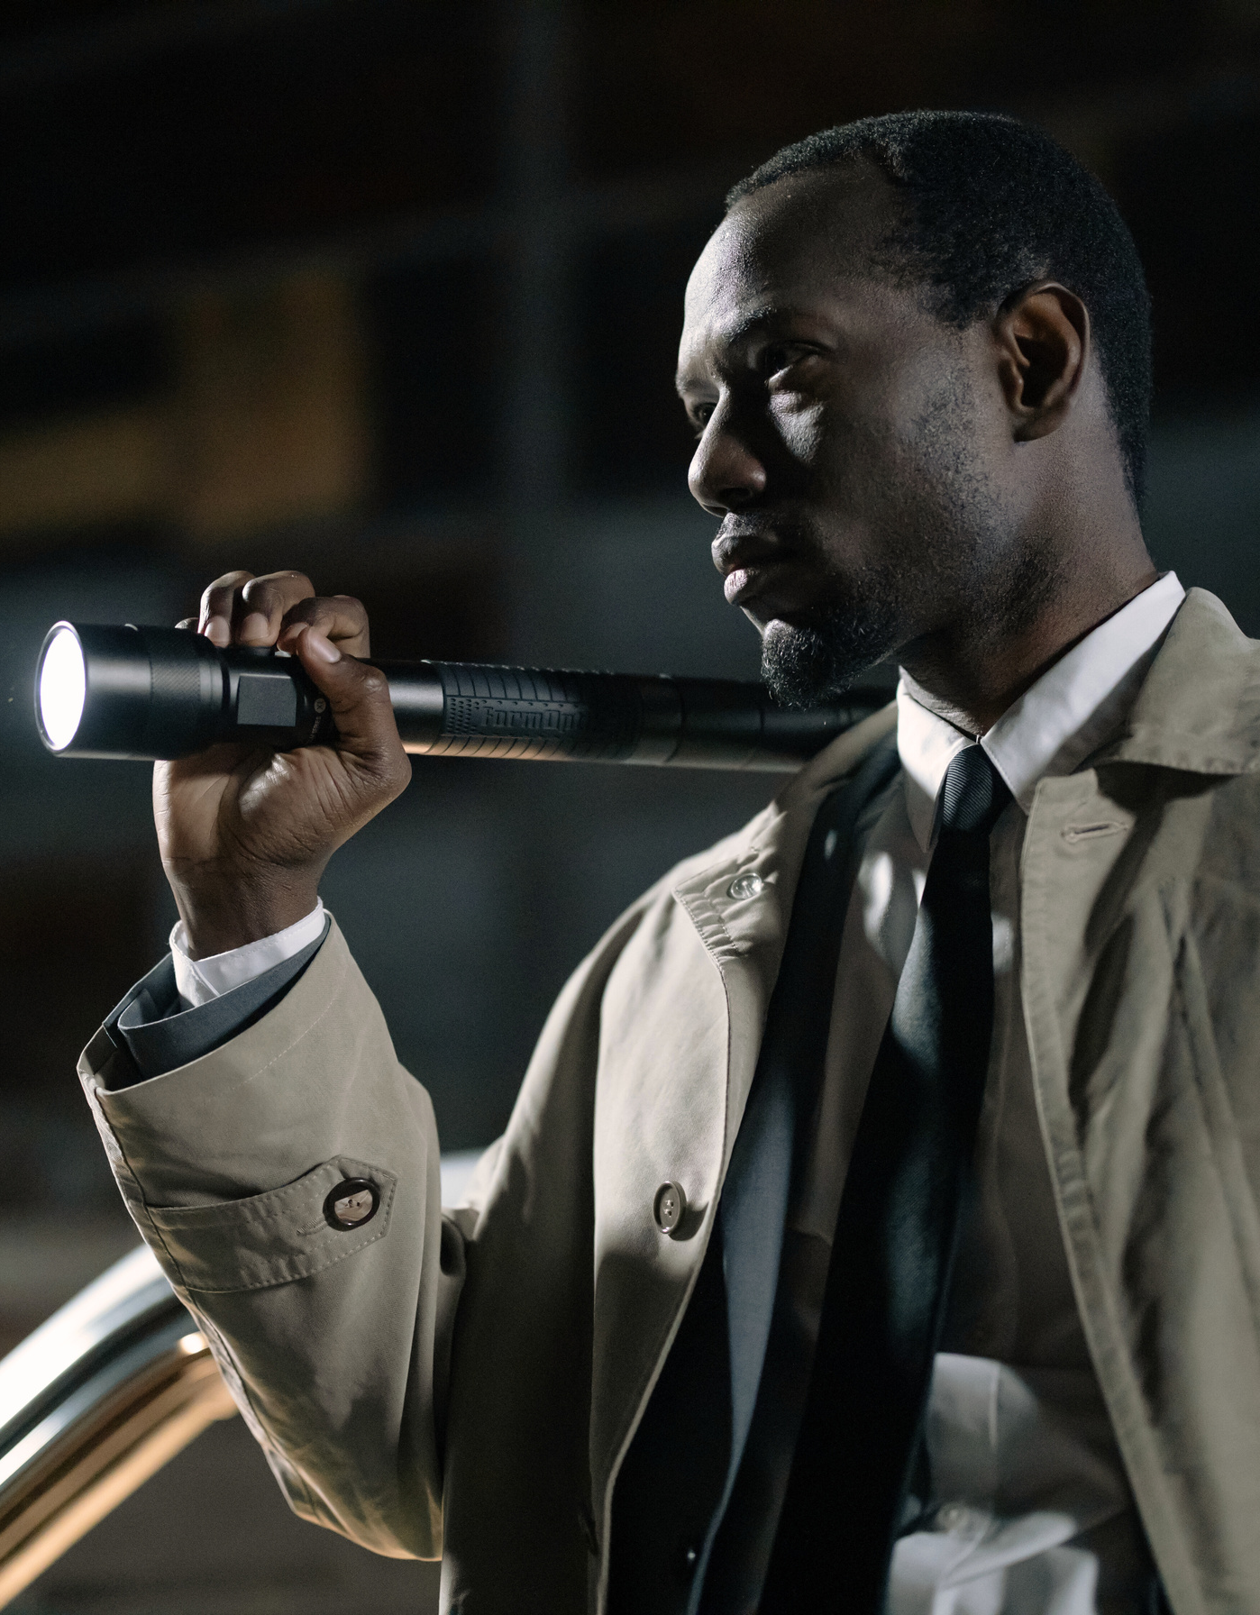
JACK THE RIPPER
In 1888, the crimes of an unknown killer shocked Great Britain. The murders took place in the dead of night (between 23.00 pm and 4.00 am), in the seedy places of London. For the cruelty with which the crimes were committed, the killer was nicknamed Jack the Ripper. The Ripper's victims were prostitutes from the slums, whose throats were cut by the killer before opening the abdominal cavity. The extraction of internal organs from the victims caused speculation that the killer was a professional surgeon. From August to October 1888, Scotland Yard received many letters allegedly written by the killer's hand. A human kidney belonging to one of the victims was attached to one of them, nicknamed the "Letter from Hell" by the newspaper, which was received by Inspector George Lusk. The murders that terrified Londoners from August 6 to November 9 stopped as suddenly as they began, and remained unsolved.
.

Slide 5
THE GREAT MAIL TRAIN ROBBERY
On August 8, 1963, Scotland Yard had to investigate one of the most sensational robberies of the twentieth century. 2.6 million pounds ($60 million at the current exchange rate) were stolen from the Royal mail train. The robbery lasted only 20 minutes. The crime was planned ingeniously simple – the robbers changed the semaphore signal to stop the train. Then 15 men in ski masks and helmets attacked the driver, stunning him with a metal rod, unhooked two cars and drove them to a safe place to safely take out 120 bags of banknotes. The audacious robbery was widely publicized. The reputation of Scotland Yard was at stake, and it became a matter of honor for the British police to solve the crime and detain the robbers. As a result of a large-scale operation, the criminals were caught and sentenced to long terms of imprisonment. But the most famous gang member Ronnie Biggs managed to escape and hide in Brazil. In 1974, the British police tried to get him arrested and extradited, but to no avail. The robber's Brazilian girlfriend was pregnant, and as the father of a Brazilian child, Biggs could not be extradited to another country. And in 1997, the Brazilian authorities decided that too much time had passed since the crime, so the famous robber could no longer be extradited. Only in 2001, already an elderly man, Biggs voluntarily returned to his homeland and surrendered to the police. He was arrested as soon as he got off the plane. The robber at that time was 71 years old, and he was threatened to serve 28 years of his sentence. At the moment, Biggs is whiling away his last days in a London prison hospital.

