Slide 1
The World
March holidays

Slide 2
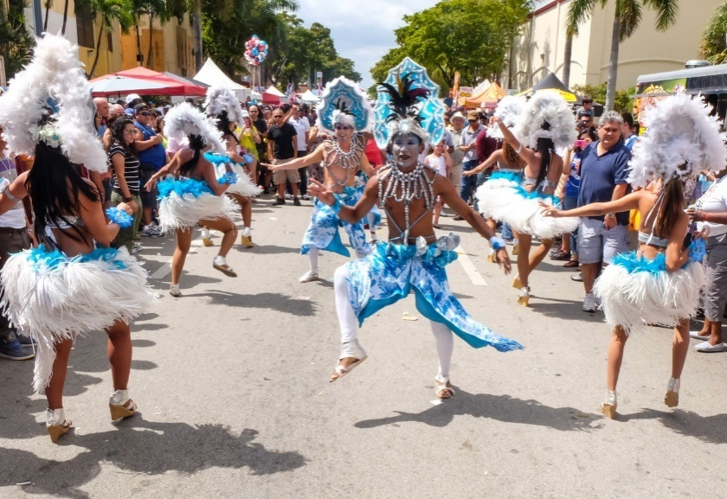
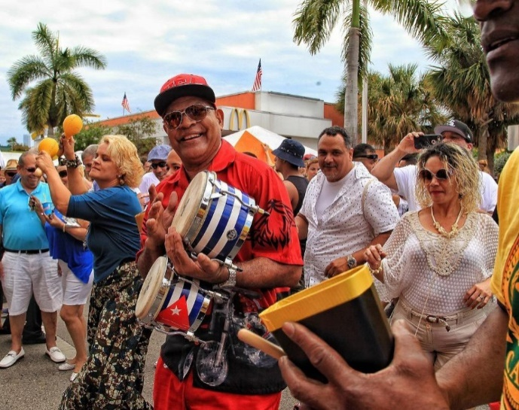
Calle Ocho
(March 1-9)
Miami Carnival is one of the largest street festivals in the world. It was first held in 1978. Cuban, Caribbean and other Latin American music and art. The kingdom of salsa, merengue and all other styles of dance. It takes place on the territory of 20 blocks along Calle Ocho Street and attracts about a million tourists and participants to Miami. There is a special children's area.

Slide 3
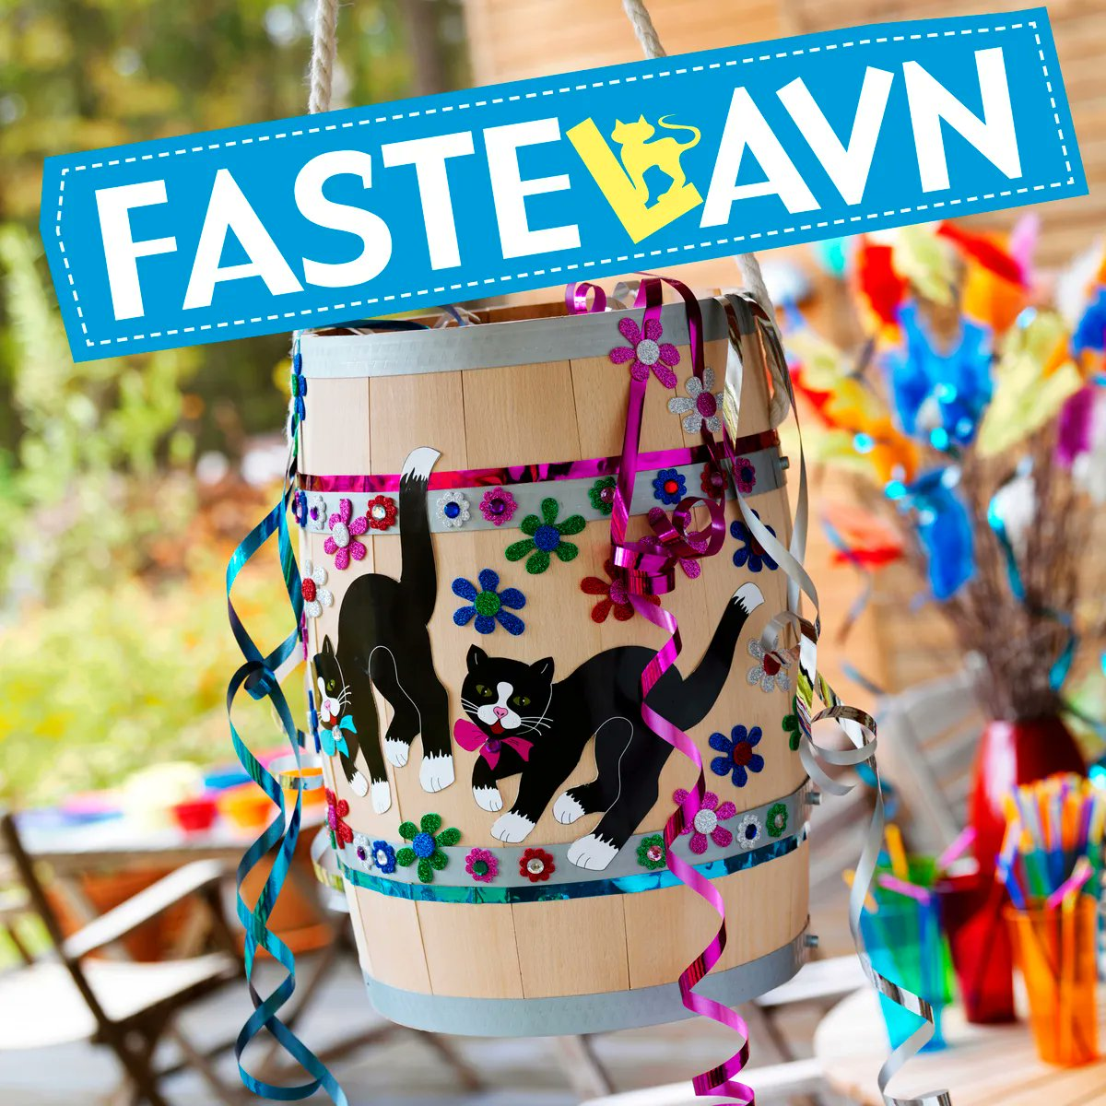
Fastelavn
The Danish Fastelavn holiday marks the beginning of preparations for a long fast. It is celebrated annually on the Monday preceding Catholic Ash Wednesday, which falls at the end of February – beginning of March. On this day, in towns and villages, children get up first and wake up their parents with festive songs. Then they dress up in colorful costumes, put on masks and, picking up birch branches of Fastelavnsris decorated with bright paper and sweets, wander through the streets and sing songs in the hope that the townspeople will fill their boxes with sweets. At the end of the day, the children gather around a large wooden barrel, which is hung on a tree or on a pole. They take turns trying to split her with a baton. The one who succeeds in this becomes the owner of a pile of sweets and fruits with which the barrel is filled; he is appointed king of Fastelavn and a crown of shiny paper is placed on his head, after which the king chooses a queen for himself. In the old days, a black cat was put in a barrel and beaten on the barrel until the animal died. Only adults did this. In modern Denmark, only a black cat painted on the side of a barrel reminds of this barbaric tradition.

Slide 4
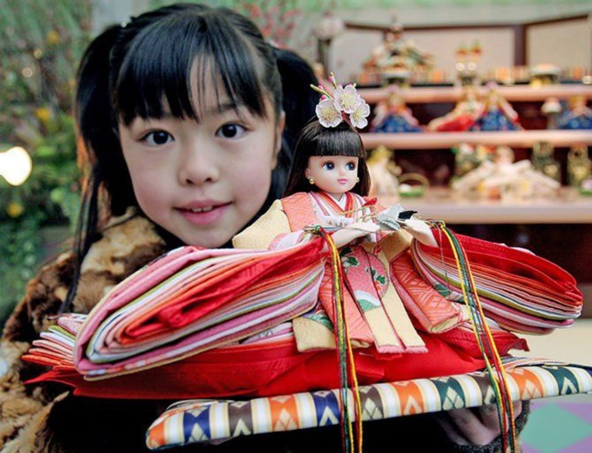
Girls' Holiday (女の子の休日)
Every year on March 3, Japan celebrates the holiday of girls — hina-matsuri. The traditional gift for this occasion are Japanese hina dolls, which gave the name to the holiday. On this day, the girls exhibit all their dolls and compete to see who is more beautiful. In modern Japan, this is one of the few days when a woman is officially honored. Families where there are girls arrange a reception for relatives and friends who wish the girl to grow up healthy, beautiful and happy. Happiness for a Japanese woman is a good marriage and a lot of children, better than boys.The first such holiday in a girl's life has a special name — hatsu-dzekku. The girl receives the first dolls in her life as a gift from her grandparents. Usually this is a set of expensive traditional Japanese dolls — up to 15 dolls can fit on a special stand with seven steps. Dolls depicting the emperor and the Empress are placed on the top step. Girls are also given miniature furniture and lamps on this day: a woman should be a good hostess. Since the end of the VIII century A.D., girls from noble families have been playing with paper dolls, and adults have been erasing their sins with a special hitogata paper. Then the paper and dolls were given to the river. Now dolls are not allowed on the water: they are too expensive. They are passed down from generation to generation; not responsible for human sins, they keep the female tradition of the genus.

