Slide 1
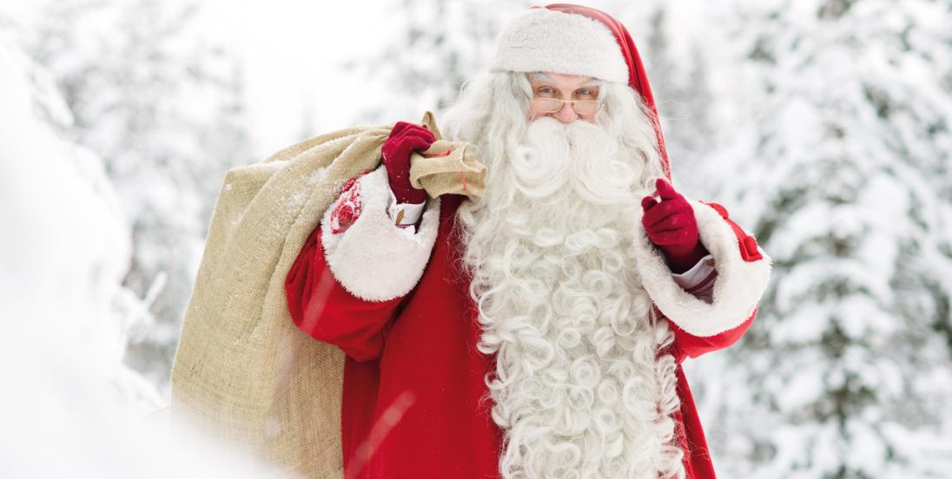
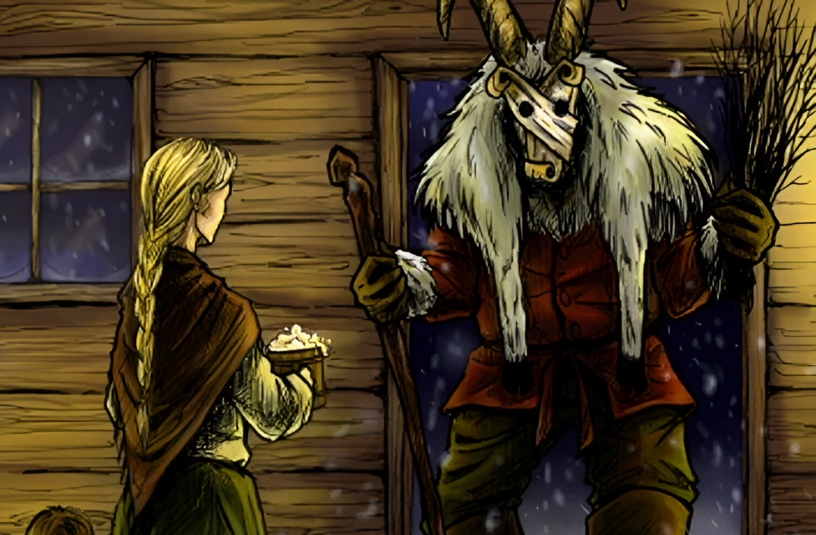
Finnish Santa Claus
The World
Santa Clauses around the world
Nowadays, Finnish Santa Claus, or Joulupukki is not differ from the Santa we know. But it wasn’t always this way.
These days, Joulupukki visits homes to deliver gifts to children. He rings the bell and enters politely through the door, asking the still-awake families “Onko täällä kilttejä lapsia?” (“Are there any well-behaved children here?”) He wears red robes and drives a sleigh pulled by reindeer, and calls mountain Korvatunturi in Lapland home.
But originally the Joulupukki was a pagan tradition. The name Joulupukki literally means "Christmas goat“ or "Yule Goat" in Finnish language. Yule, a pre-Christian pagan festival, was a midwinter celebration with feasting and sacrifice that took place in many Germanic cultures. Before his transformation Joulupukki was a really scary character, demanding gifts and scaring naughty children rather than rewarding the good ones…
Interesting thing is that classic Coca-Cola version of Santa Claus, the most popular St. Nicholas representation in the world, was made by Haddon Sundblom – an American artist who is have Finnish and Swedish roots

Slide 2
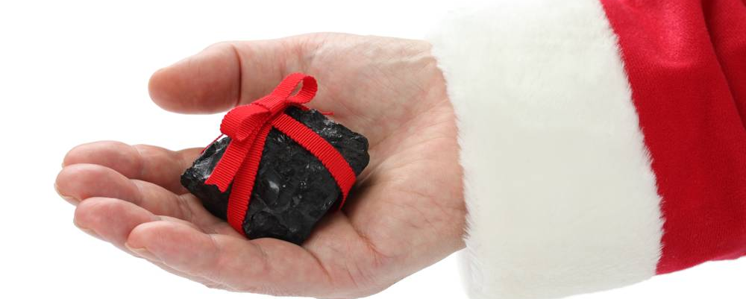
Spanish Santa Claus
In Spain, not Santa Claus gives gifts, but a whole army of wizards - Magi, Pope Noel, Olentsero and many others.
In the province of Navarra and the Basque Country, for Christmas, gifts by obedient children are distributed by a colleague of Santa Claus named Olentzero. The name of this good man is literally translated as "the time of good people. «With Olentzero, there is always a flask with good Spanish wine, because his long working night promises not to be from the lungs. He does not climb into the fireplace, but leaves his gifts on the balcony.
And in some regions of Galicia there is a legend that El Apalpador comes on Christmas night and feels the tummies of children. Those who, in his opinion, eats poorly, he leaves chestnuts under a pillow to get better. And with dumped children he puts coal to heat the house.

Slide 3
Japanese Santa Claus
Segatsu-san and Oji-san In Japan, two Santa Claus compete - Segatsu-san and Oji-san. Unlike the young Oji, the traditional Shogatsu-san has to go home for a whole week, which the Japanese call "golden". Segatsu-san is dressed in a sky-blue kimono, he does not give gifts to kids, their parents do it for him.
For the Japanese Santa Claus, small gates made of bamboo sticks with pine branches are built in front of the houses. And richer people install dwarf pine, plum or peach blossom trees. Children dress up in new clothes to be healthy and lucky in the coming year. They play hanetsuki, participate in New Year's performances, build houses and snow figurines (weather permitting), fly kites, and at night they always put pictures of sailboats under their pillow so that they are visited by the Seven Gods of Happiness.

Slide 4
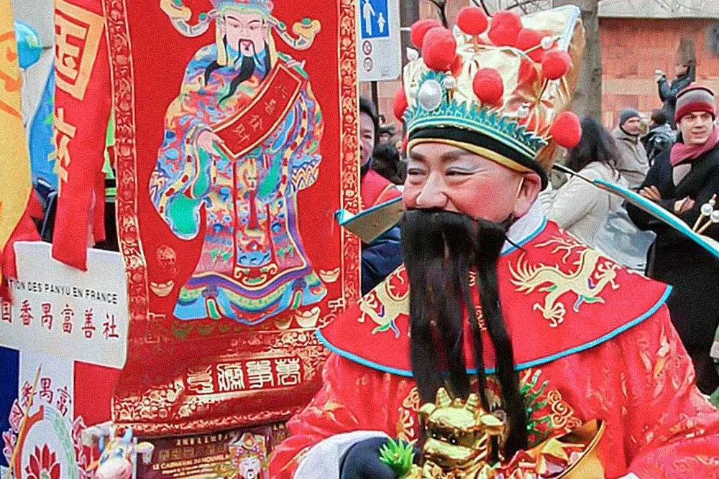
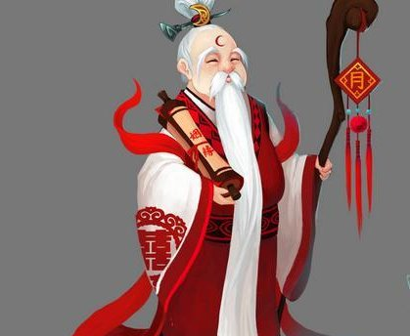
Chinese
Santa Claus
Chinese Santa Claus, whose name is Shan Dan Laozhen (Dong Chen Lao Ren or Sho Hin).
Shan Dan Laozhen is wearing a long red silk robe. This color is most common, however, this character can be seen in a blue and white coat. He wears a very unusual headdress of black or gold color.
Shan Dan Laozhen brings gifts at night. It is customary to lay them out in specially hung socks. In most cases, national envelopes of red color – laysi are used. It is customary to put an even amount of money inside this envelope for good luck and fulfillment of all cherished desires.
At the same time, it is customary to give such gifts to both children and adults. Envelopes need to be decorated as brightly as possible, add various patterns and congratulatory inscriptions.

