Slide 1
The World
November holidays
Every country has its own customs, traditions and holidays. It is almost impossible to list all the holidays of the country but here it is written about the most important and traditional ones:
Thanksgiving Day,
Guy Fawkes Night,
St. Andrew's Day,
Memorial Day.

Slide 2
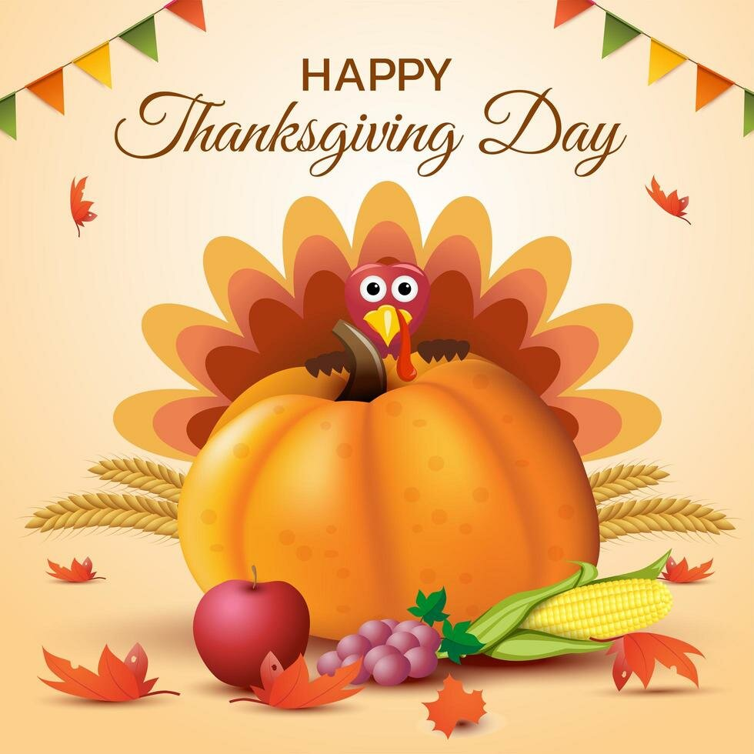
Thanksgiving Day is celebrated in the United States on the last Thursday in November. This holiday is one of the big six major holidays of the year. People of all faiths celebrate this day. They give thanks for the many good things in their lives.
Thanksgiving Day has been an official United States holiday since 1863, when President Abraham Lincoln, proclaimed that Thursday, 26 November, should be a day of national gratitude. Before that this holiday celebrated English settlers of the Plymouth colony, who had to endure a rough first winter in New England.
Thanksgiving Day is a traditional family holiday. So on that day families always come together, especially for the wonderful meal. A large roasted turkey with stuffing is the most common main dish of a Thanksgiving dinner, that’s why Thanksgiving is sometimes called “Turkey Day”. At Thanksgiving 2012, were purchased more than 46 million turkeys by Americans. Turkey usually served with sweet potatoes or mashed potatoes, vegetables, cranberry sauce, and pumpkin or apple pie. Apple cider is a traditional drink.

Slide 3
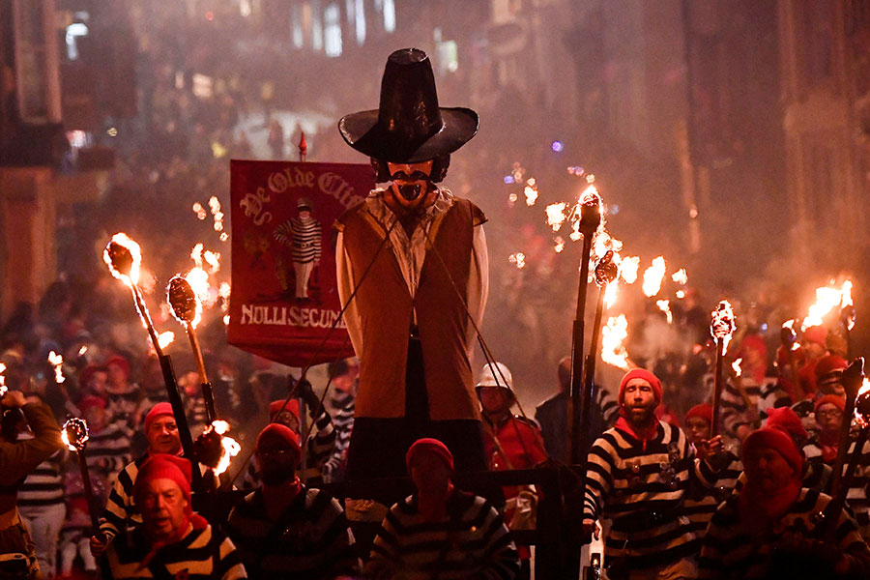
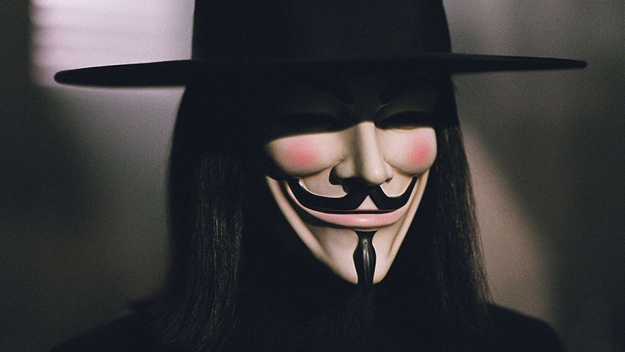
Guy Fawkes Night: November 5th
Guy Fawkes Night is one of the world's most famous specific holidays in the UK.
Guy Fawkes is one of the participants in the infamous Gunpowder Plot. On the night of November 4-5, a group of conspirators attempted to blow up the Parliament building, namely Guy Fawkes had the task of setting fire to a barrel of gunpowder. The plot was uncovered, Guy Fawkes was arrested, and members of Parliament invited the people of London to take to the streets and celebrate the king's salvation from death. In one of the squares of the city, an effigy of Guy Fawkes was made of straw, and then burned.
Since then, Guy Fawkes Night has become a celebration when lights are lit all over the country and fireworks and firecrackers are launched.
This day is widely reflected in popular culture. For example, in memory of the Gunpowder Plot, the ballad "Remember, remember the fifth of November" was written, which is still being read out on Bonfire Night.
A lot of tourists come to England specifically to catch this large-scale celebration and see it with their own eyes.

Slide 4
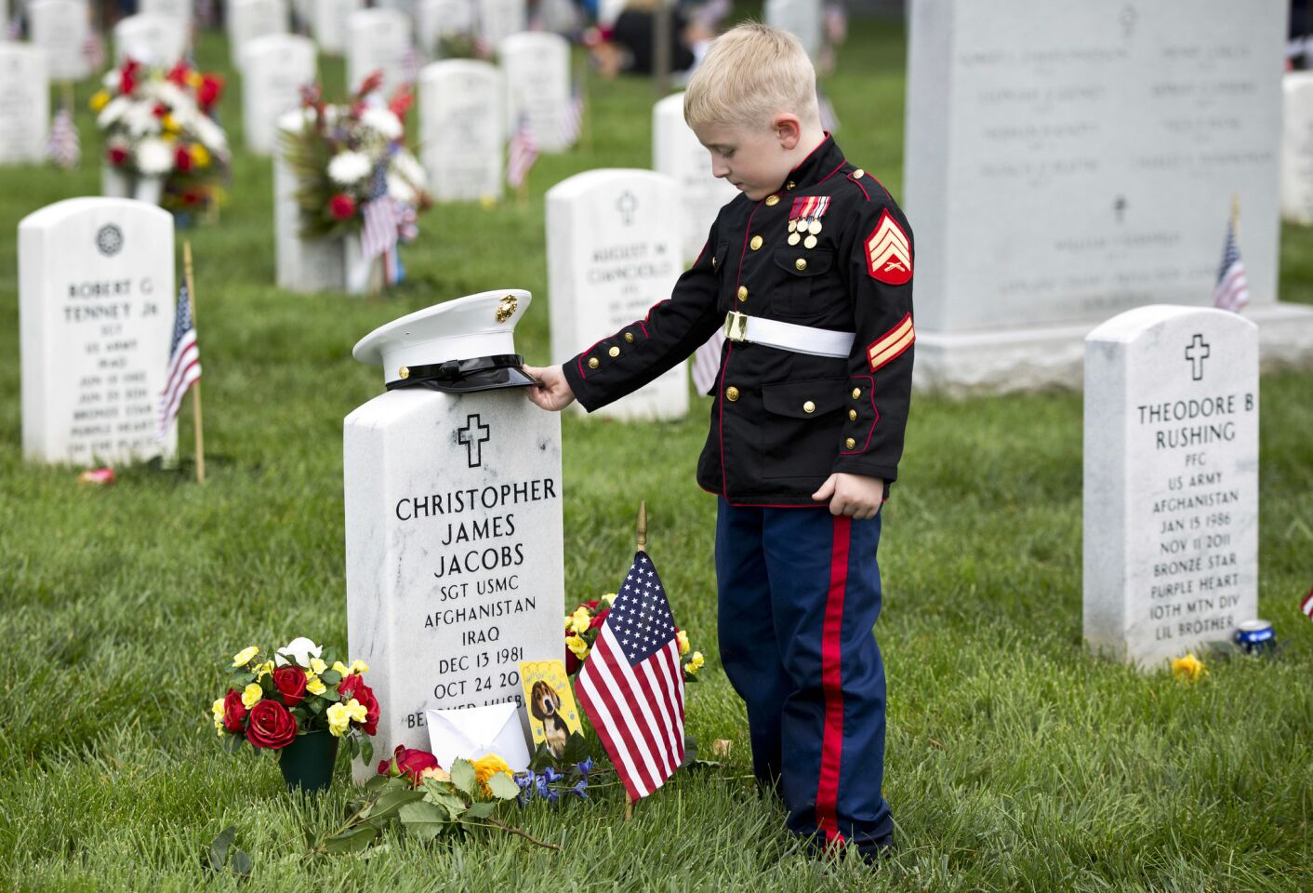
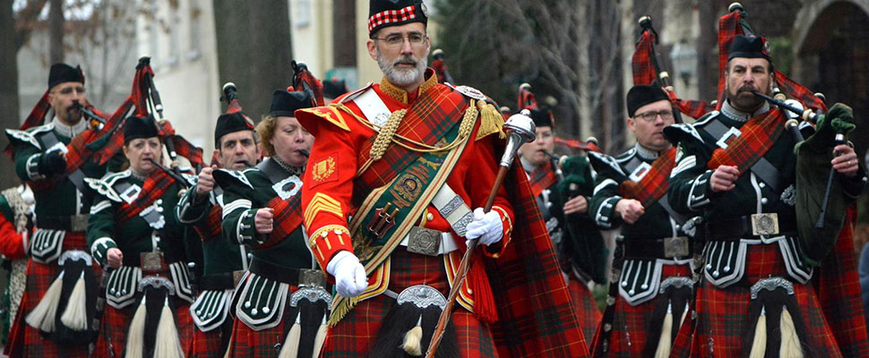
St. Andrew's Day: November 30
Is the feast day of Andrew the Apostle. It is celebrated on 30 November. Saint Andrew is the disciple in the New Testament who introduced his brother, the Apostle Peter, to Jesus, the Messiah. Saint Andrew is the patron saint of Scotland, so this day is widely celebrated in the country. On this day, the Scots organize mass celebrations and gala dinners, honoring their patron and protector.
At the celebrations in honor of St. Andrew's Day, dancing, bagpipes, poetry reading are always present.
Memorial Day: November 11
Memorial Day is a holiday on which the British remember the soldiers who died on the battlefields of the First World War. The symbol of this day is a red poppy. It is pinned to the chest, where it blooms like a bloody wound. This symbol originated from the poem "On the fields of Flanders", where both the military feat of soldiers and the beauty of poppy flowers were sung at the same time. On this day, it is customary to lay flowers at all military monuments: not only those dedicated to the events of the First World War.

