Slide 1
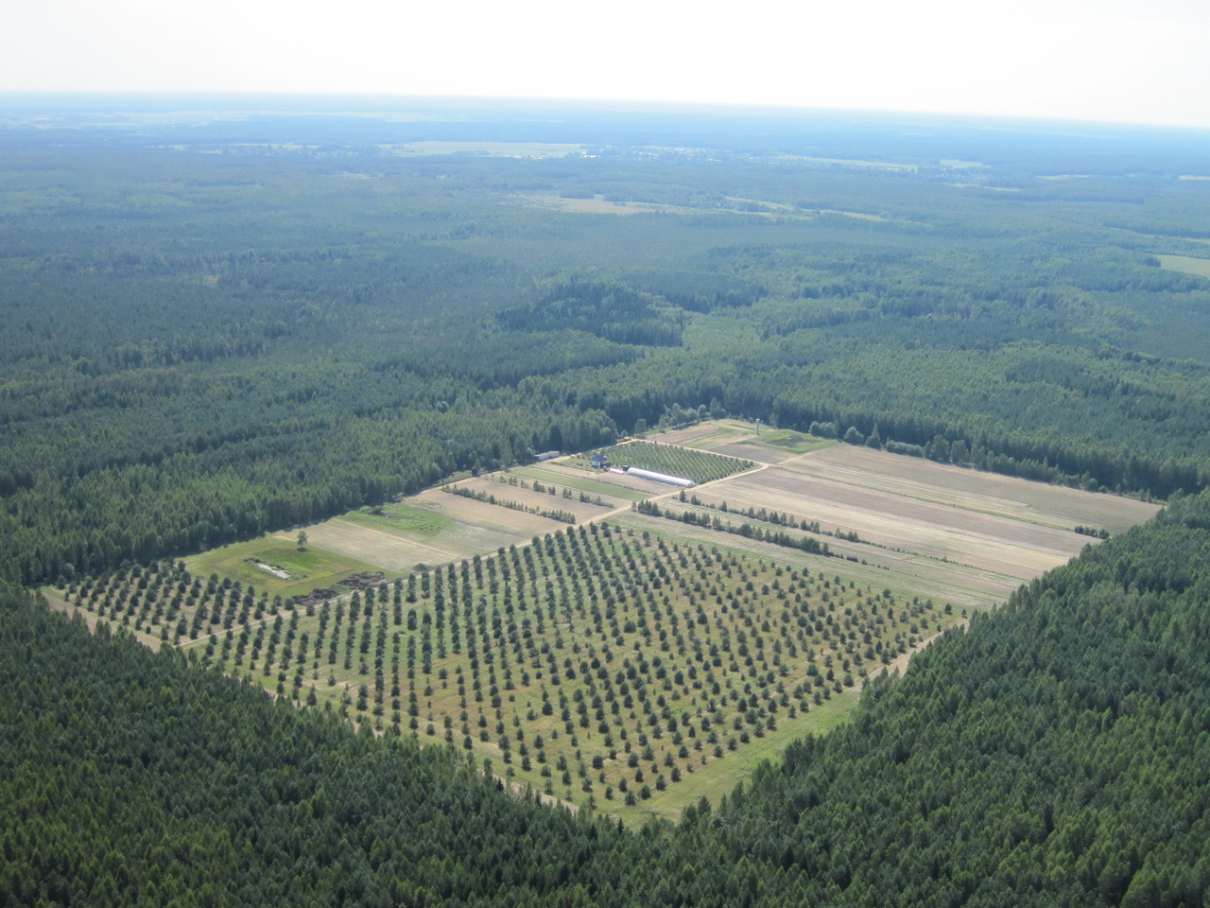
The World Forestry of Republic of Belarus (History)
In 1920-1930, forestry management issues were under the jurisdiction of the People's Commissariat for Agriculture of the BSSR. In August 1930, all forests, with the exception of forests of local importance, were transferred to the newly formed Lesbel of the Supreme Economic Council of the BSSR. On the basis of the Office of the Authorized Main Directorate of Forest Protection and Plantations under the Council of Ministers of the USSR for the BSSR, the Presidium of the Supreme Council of the BSSR on July 1, 1947 created the Union-Republican Ministry of Forestry of the BSSR. The current regulation on the ministry was approved by the Decree of the Council of Ministers of the Republic of Belarus dated March 16, 2004 No.298 “Issues of the Ministry of Forestry of the Republic of Belarus”.

Slide 2
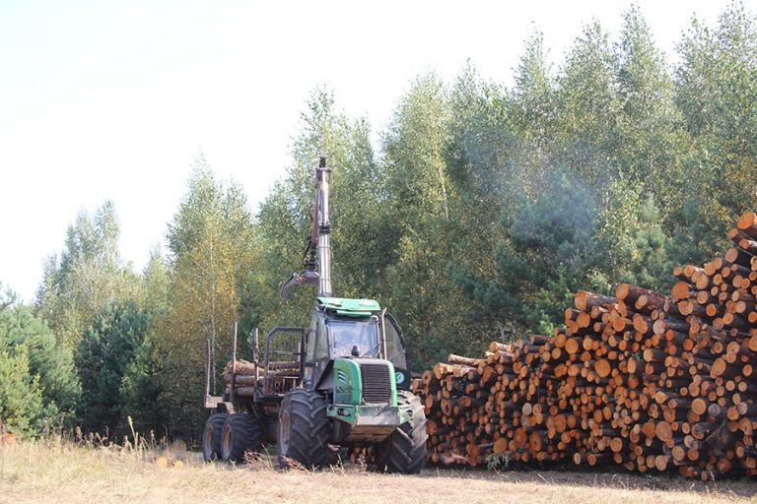
Forest fund
Belarus is among the top ten forest states in Europe. Belarus' forestry, successfully implementing the principles of sustainable multi-purpose forest management, is important for the stable functioning of the country's forest sector, contributes to the development of related sectors of the economy, makes a significant contribution to the implementation of international agreements signed by our country at the global level in the field of environmental protection. Its economic, environmental and social role is steadily increasing. As a result of the purposeful work of foresters, the main quantitative and qualitative indicators of forests have improved since 1994. The forest cover of the republic is close to optimal and is 40.1%. Over the past 60 years, the forest cover of the republic has almost doubled and reached its maximum value for more than a century (1901 – 37.6%) and is currently continuing to grow.

Slide 3
Main tasks
implementation of the functions of state regulation in the field of forestry;
implementation of a unified state policy in the field of use, protection, protection of the state forest fund and forest reproduction, coordination of activities in this area of other republican public administration bodies, local executive and administrative bodies, legal entities, regardless of ownership forms;
increasing forest productivity, ensuring the creation and cultivation of forest plantations based on the widespread use of scientific and technical achievements to fully meet the needs of the economy and the population in all types of forest products;
state control over the state, use, protection, protection of the state forest fund and reproduction of forests;
implementation of measures for the protection and protection of forests;
implementation of a unified economic policy in the field of forestry, ensuring the creation of the necessary conditions for the effective work of the

Slide 4
Classification of forms of forestry
Classifications of forestry forms are compiled according to economic, natural history and technical characteristics. Forestry is divided into continuous and periodic (in which the entire area occupied by the forest is cut down every few years when the forest reaches a ripe state)
In addition, the farm is divided into high-barrel, low-barrel and medium. High-stemmed is called forestry, which includes plantings grown from seeds, in which each tree is used once and the next generation of trees grows by seed at the cutting site. In a low-stemmed farm, each tree capable of producing shoots repeatedly participates in the formation of subsequent plantings grown on the same area. If the plantings consist of both seed and overgrown trees, clearly separated in size and age, then such forestry is called average.

