Slide 1
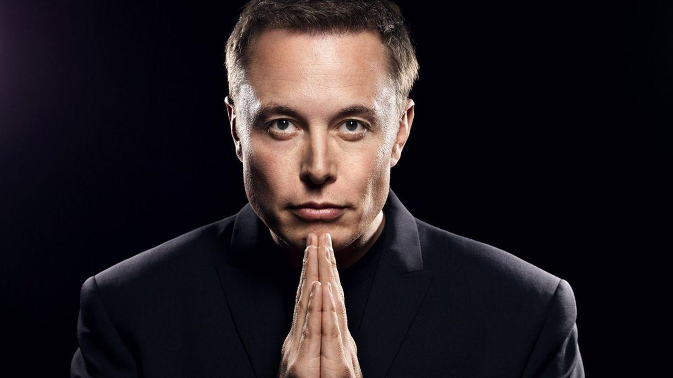
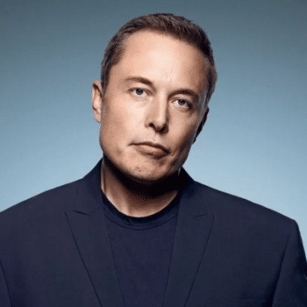
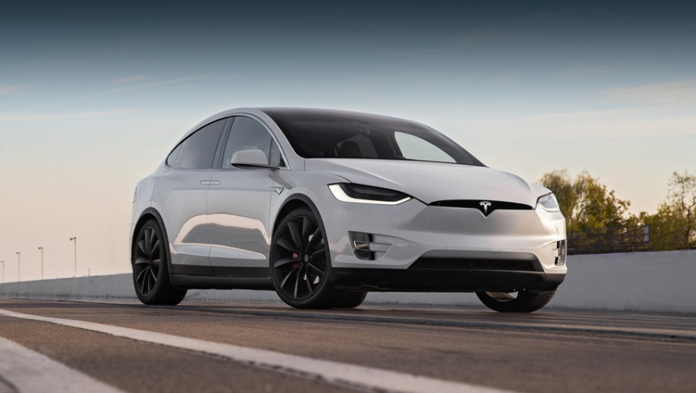
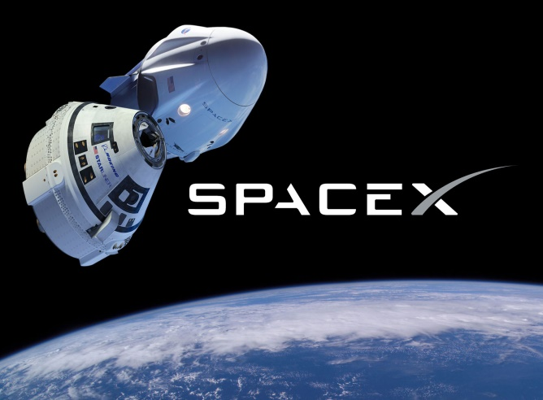
ГГУ им. Ф.Скорины
THE WORLD
Famous people of our time
Elon Musk
Elon Musk is a 50-year-old American inventor, visionary and billionaire. The entrepreneur was born in the family of engineer Errol Musk and nutritionis t and famous model May Musk on June 28, 1971 in Pretoria, South Africa. Musk is best known for two projects -electric car manufacturer Tesla and space company SpaceX. On May 30, 2020, SpaceX made the first ever private manned launch of the Crew Dragon into space. Prior to this, for nine years, astronauts were delivered to the ISS only by Russian spacecraft of the Soyuz series. SpaceX is also actively developing a project to send Internet satellites into low Earth orbit. With the help of a grouping of such devices, Musk intends to create a global network that provides residents with broadband Internet anywhere in the world. Another well-known SpaceX project is plans for the colonization of Mars by earthlings.

Slide 2
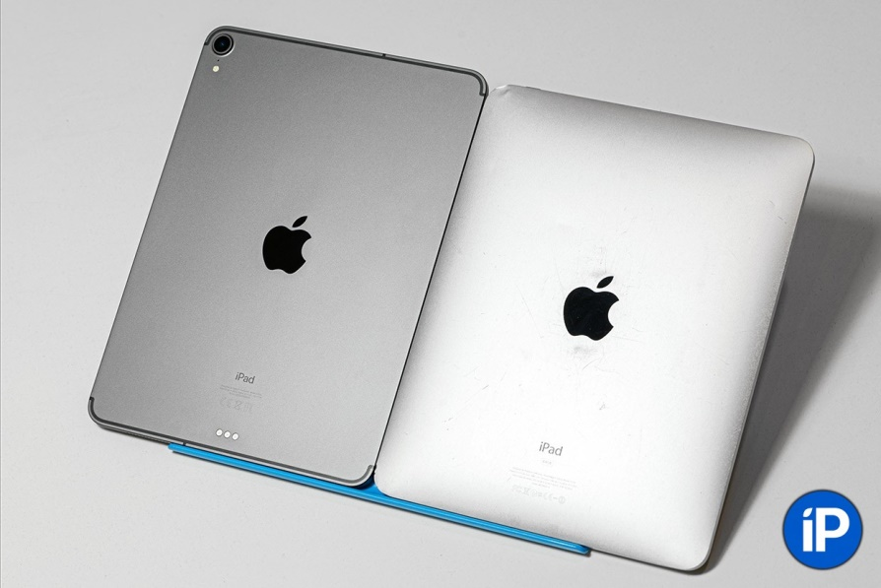
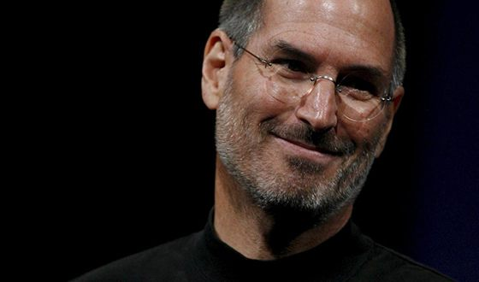
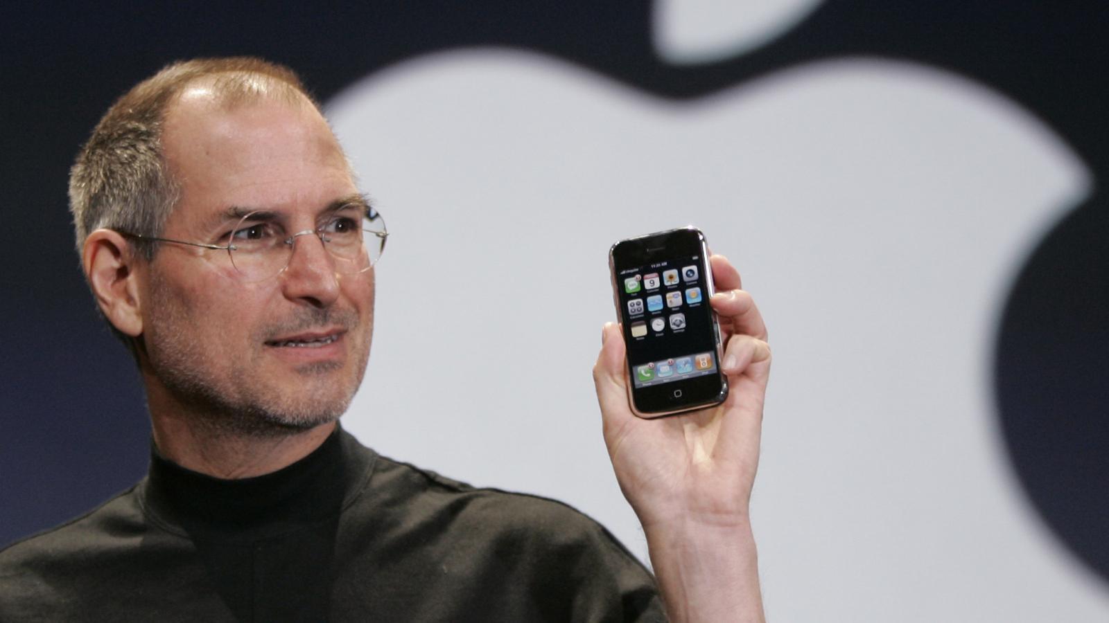
Steve Jobs
Steven Paul Jobs is an American inventor and entrepreneur. One of the founders of Apple Corporation. He went down in history first as the man who revolutionized desktop computing by inventing the PC with a graphical interface. Then he turned the music market around, invented the iPod and the iTunes music app. Finally, thanks to the invention of the iPhone, and then the iPad, Apple became the market leader in mobile gadgets.

Slide 3
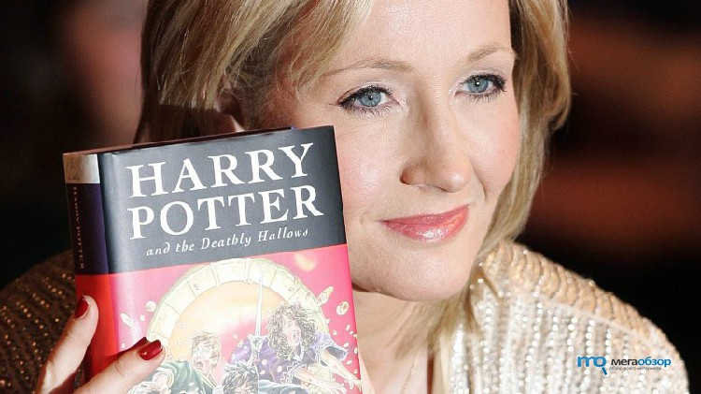
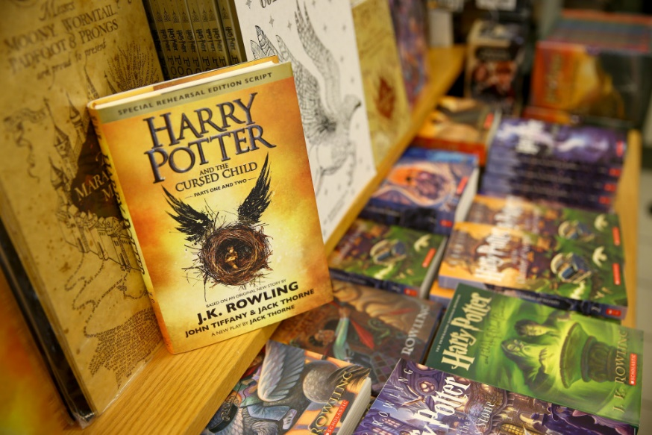
Joanne Rowling
Joanne Rowling known under the pseudonyms Joanne Kathleen Rowling and Robert Galbraith , is a british writer, screenwriter and film producer, of French origin. She is best known as the author of the Harry Potter series of novels. The Harry Potter books have received several awards and have sold over 500 million copies. They became the best-selling book series in history and the basis for a film series that became the third highest-grossing film series in history. JK Rowling herself approved the film scripts, and also joined the producers of the last two parts.

Slide 4
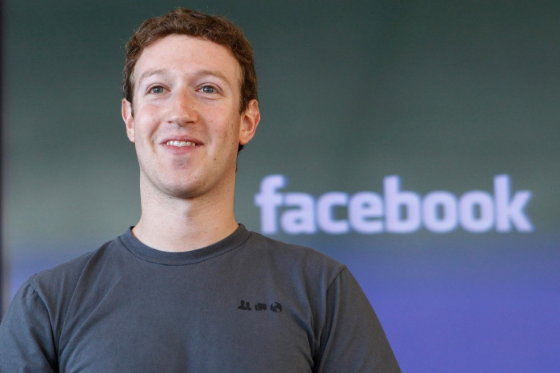
Mark Elliot Zuckerberg
Mark Elliot Zuckerberg is an American media mogul, Internet entrepreneur, and philanthropist. Known as the co-founder of Meta and is its chairman, chief executive officer and shareholder

