Slide 1
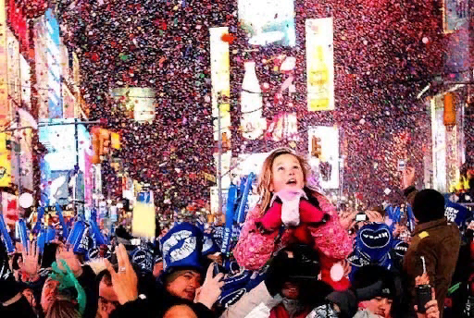
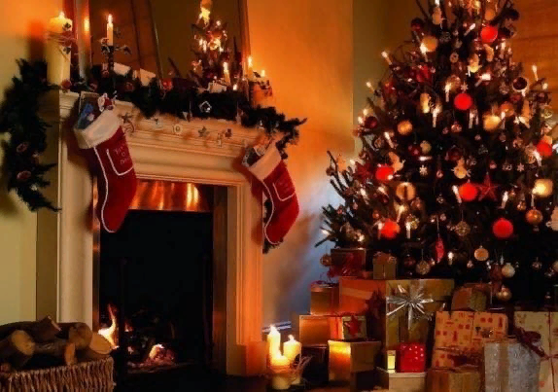
Гомельский государственный университет
имени Франциска Скорины
THE WORLD
New Year in different countries
USA
The noisy and funniest New Year events take place on Ocean Drive, the central street in Miami Beach. Here not only unusual dances and outfits are prohibited, on the contrary, they are welcome. Performances by musicians and artists take place around a Christmas tree hung with toys and garlands. Another option to celebrate a holiday is to go to a cafe or restaurant where stars perform, often of the world level. Wealthy tourists take a yacht cruise on New Years and watch the fireworks from the deck of this luxurious ship.

Slide 2
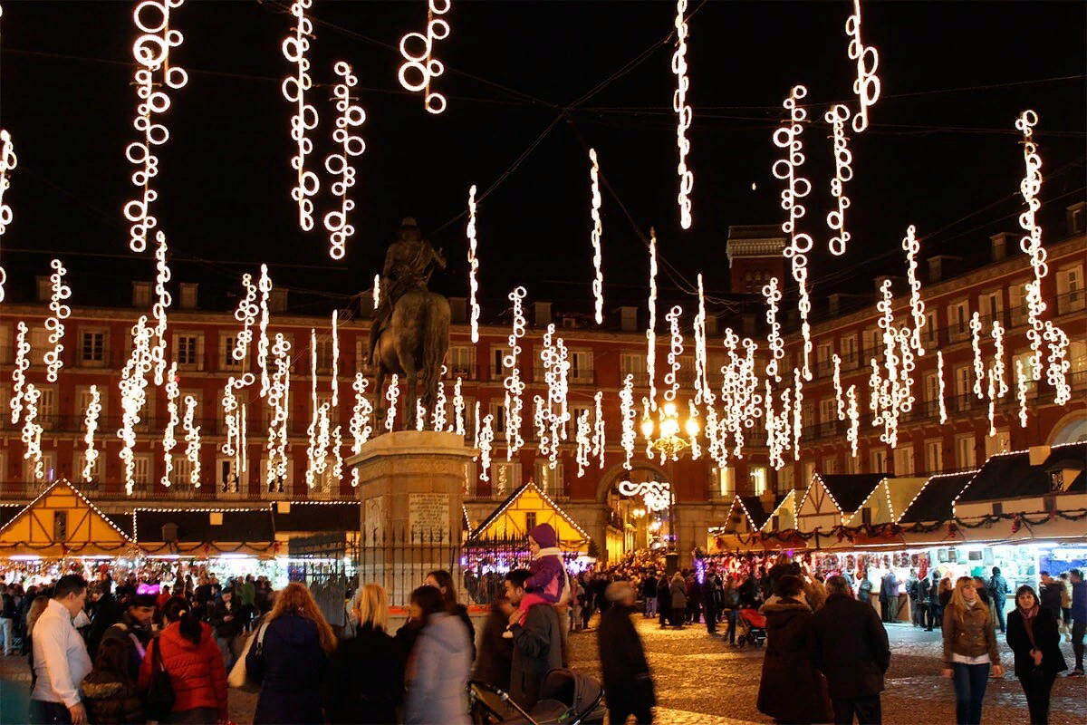
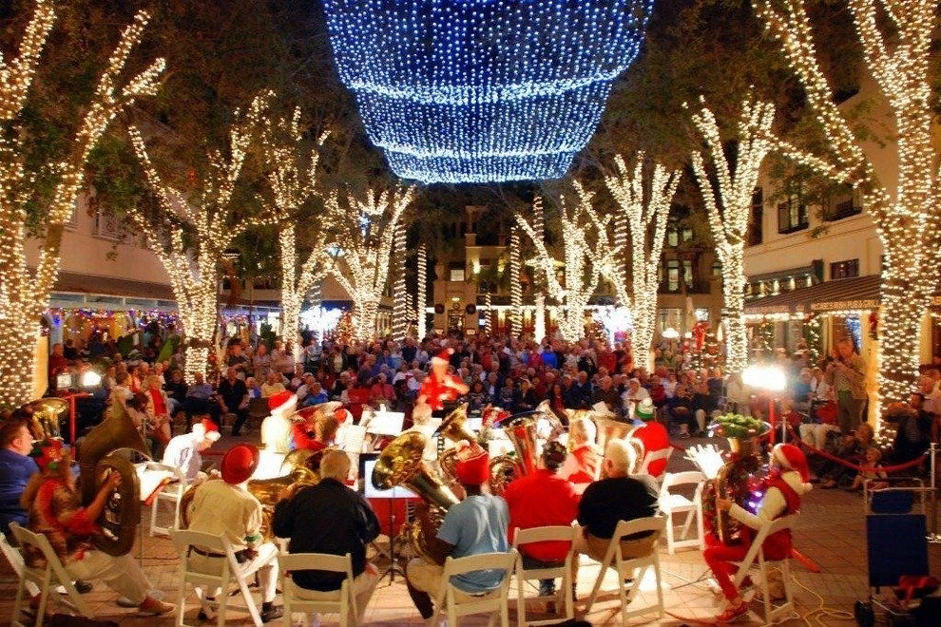
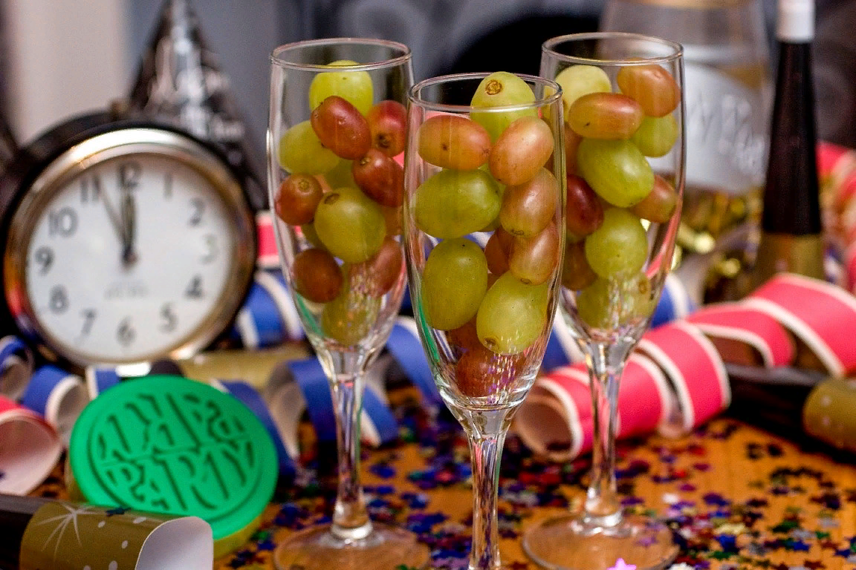
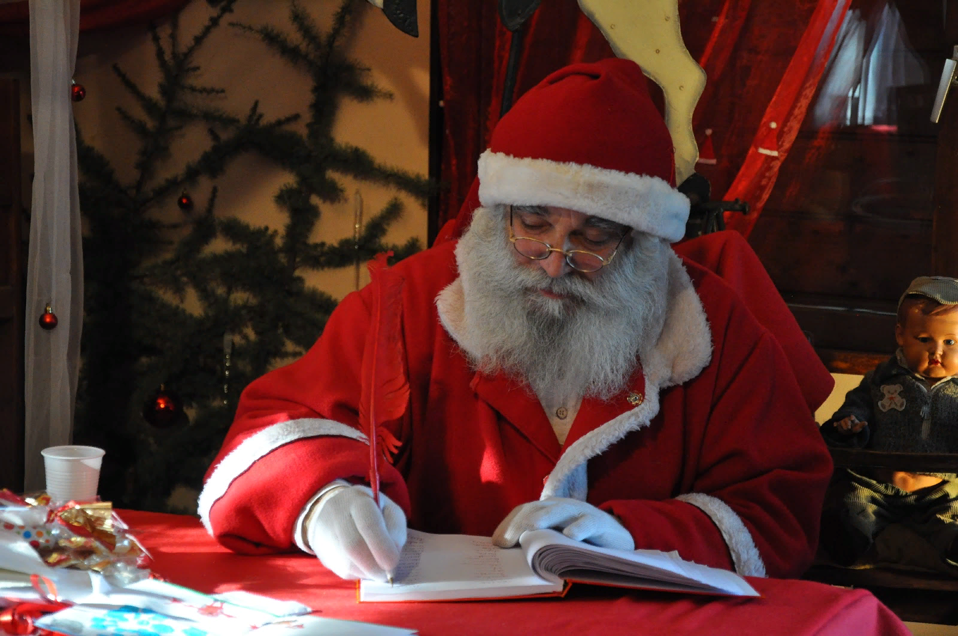
Spain
Italy
An interesting New Year's tradition in Spain is eating twelve grape berries, one for each stroke of the clock. During this process, people make twelve wishes. It is believed that the one who managed to eat all the grapes will definitely be lucky next year. They tend to wear red underwear, clothes and accessories. This color symbolizes good luck, well-being and success. Creative residents of cities come up with fancy costumes and carnival masks for themselves in advance.Gorgeous fireworks are the hallmark of the Spanish New Year festivities. Nightlife in the cities does not stop all 12 days.. But theaters and cinemas do not work even during the day so that residents are not distracted by other activities and devoted the weekend to dancing and songs.
Italians are sensitive to the traditions of celebrating the New Year. They try to have fun and noisy New Year's Eve. Residents of cities go to the streets in the company of friends, where they expect the onset of midnight. With the last stroke of the chimes, they uncork a bottle of champagne. Many citizens take umbrellas with them to hide from the streams of sparkling drink.
Italians have a special approach to New Year's attire. They try to put on an element of red clothing, which symbolizes good luck and success in the coming year.
Superstitious Italians believe that the first person they meet in the new year can predict the future. Meeting with a child or a person of the clergy marks disappointment. A hunchbacked old man foreshadows happiness.

Slide 3
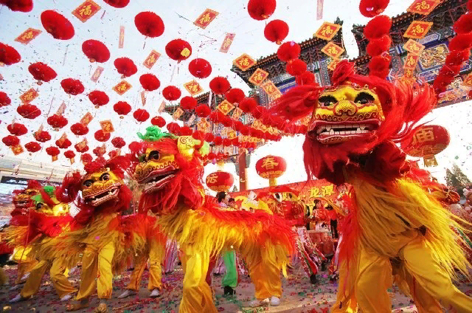
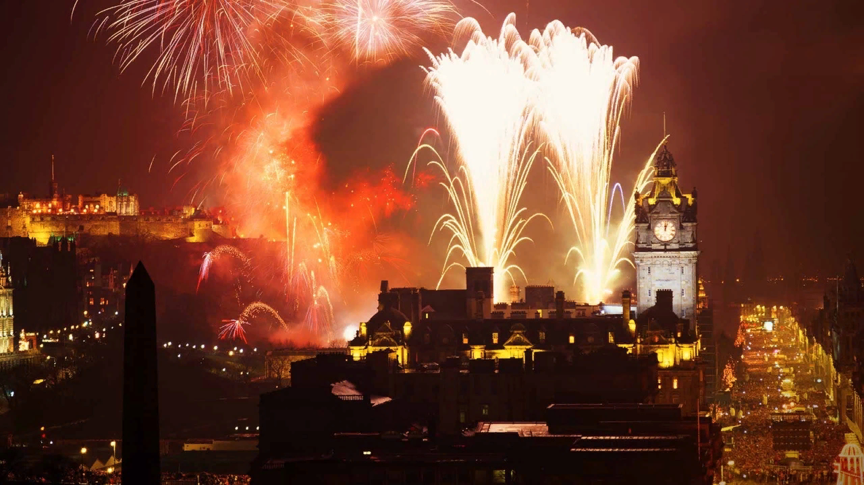
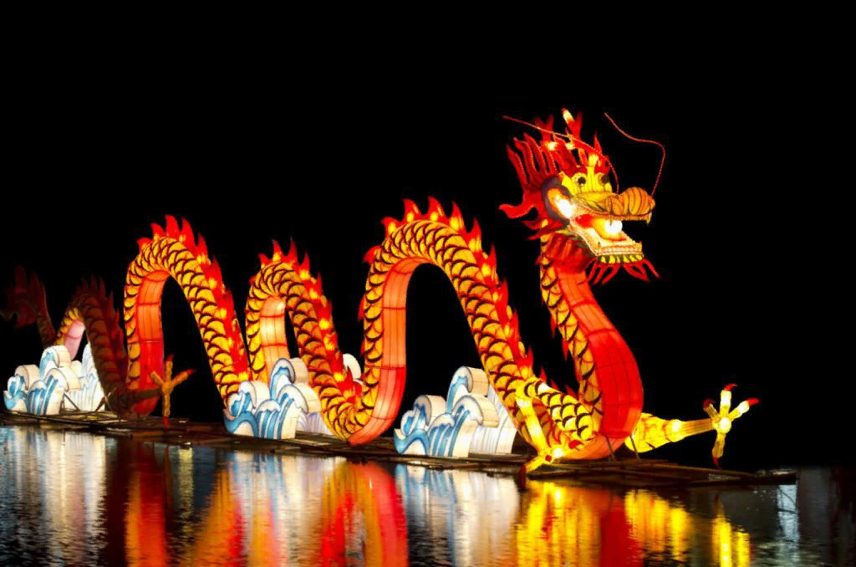
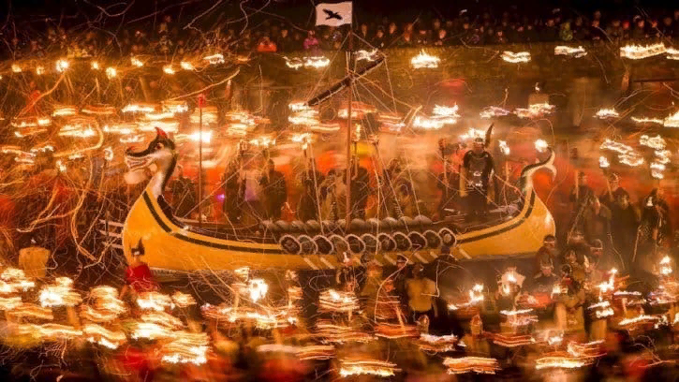
Chinese
Scotland
Chinese New Year - Chun Jie (Spring Festival) has been the most important and long-lasting holiday in China and other East Asian countries since ancient times. The Chinese begin preparations for the celebration of the New Year with the cleaning of the home, during which they throw away all the junk and unnecessary things that have accumulated over the year. Together with garbage and junk, they throw out the old stagnant energy, giving way to a new and lively one.
Special attention is paid to decorating the house with the traditional red color and its shades. The Chinese have a special ritual — paired inscriptions are pasted at the entrance to the house, the walls of apartments and houses are decorated with special paintings made of paper patterns.
In Scotland, New Year's holiday is called Hogmaney. According to an ancient tradition, on New Year's Eve, barrels of tar are set on fire and rolled through the streets, burning, in such an interesting way, the old year and inviting the new one. The Scots believe that the success or failure of the family for the next year depends on who makes the first in their home in the new year. Great luck, in their opinion, will be brought by a man with dark hair who brings gifts into the house. This custom is called first-footing.

Slide 4
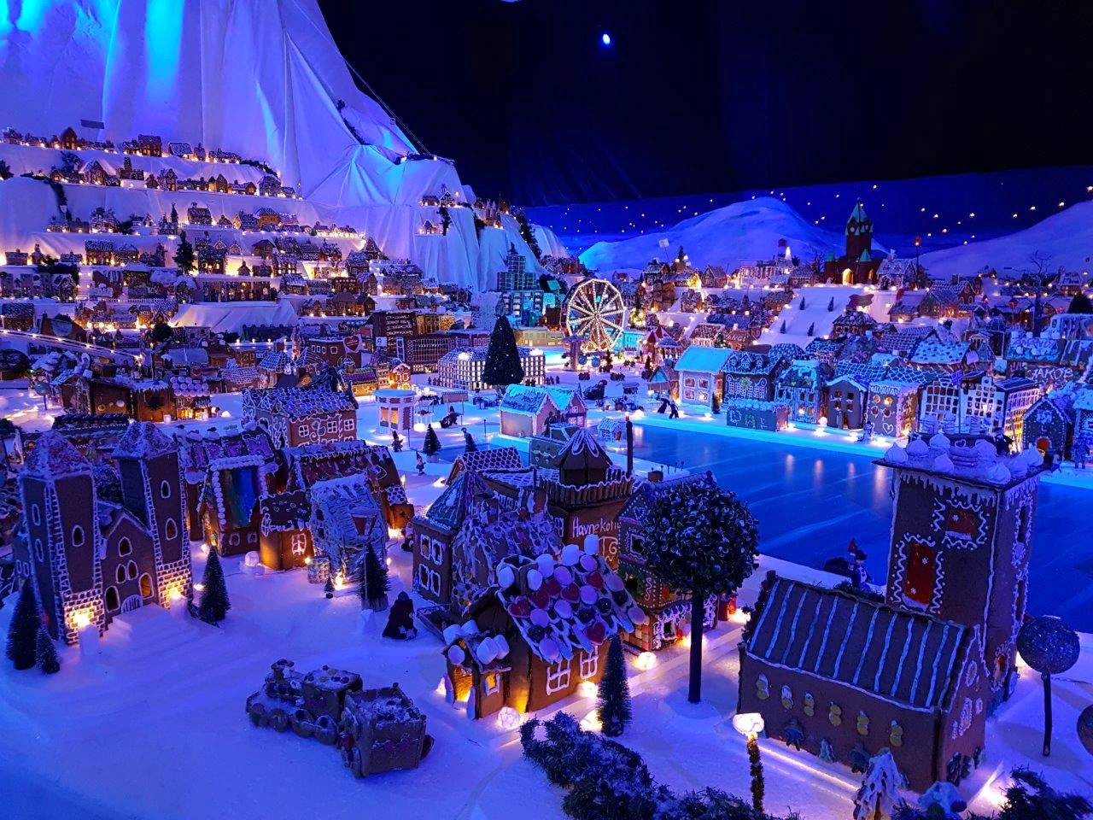
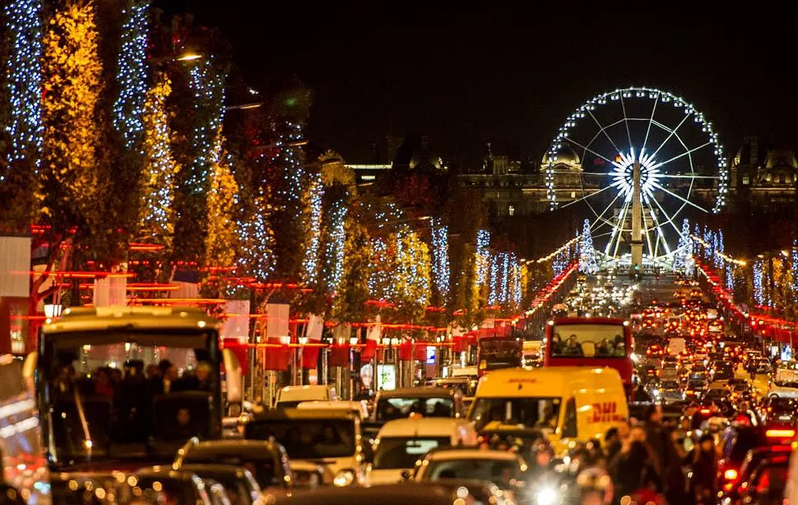
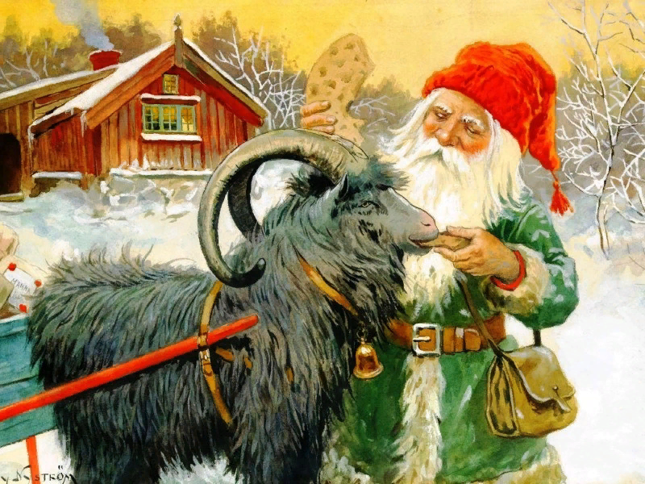
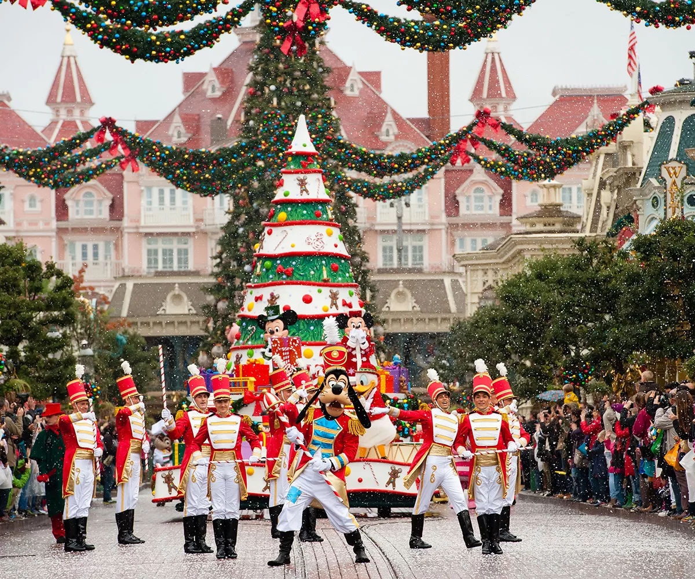
Norway
France
On the eve of the holiday, Norwegians go to church to the clergy to receive a blessing for entry into the next year.
An interesting New Year's tradition in the country is to give each other matches that symbolize comfort in the house and well-being in the family.
Norwegian children are waiting for gifts from the dwarf Yulenissen and the goat. To appease fairy-tale characters, they leave oatmeal ears in their shoes, for which they receive modest gifts.
On the festive table of Norwegians there is baked goose with apples, lamb ribs, pork, seafood and the national delicacy lutefisk.
New Year's Eve Celebration in France The French call New Year's Eve a Saint-Sylvestre. On this day they host a special New Year feast called le Réveillon de Saint-Sylvestre which consists of customary dishes like pancakes, foie gras (flavored duck or goose) and champagne. French believe this special dinner brings prosperity to the house. In South Western France, there is a tradition to attend the evening mass and participate in the torchlight procession heading towards the vineyards for mulled wine.

